Slide 1
India 1-2-3

Slide 2
INTERIOR WALL PAINTS

Slide 3
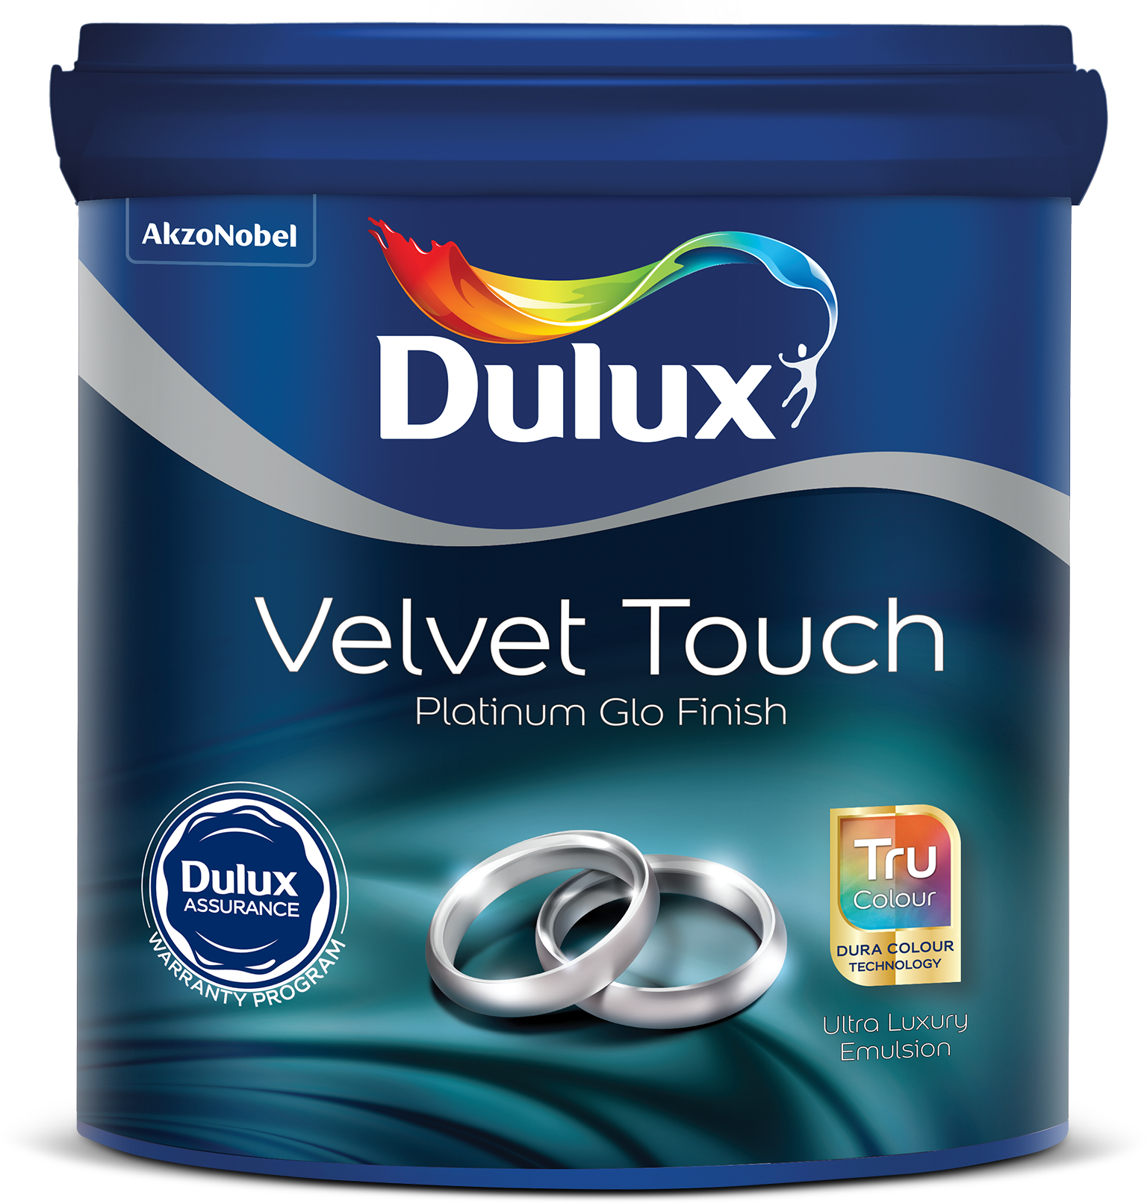
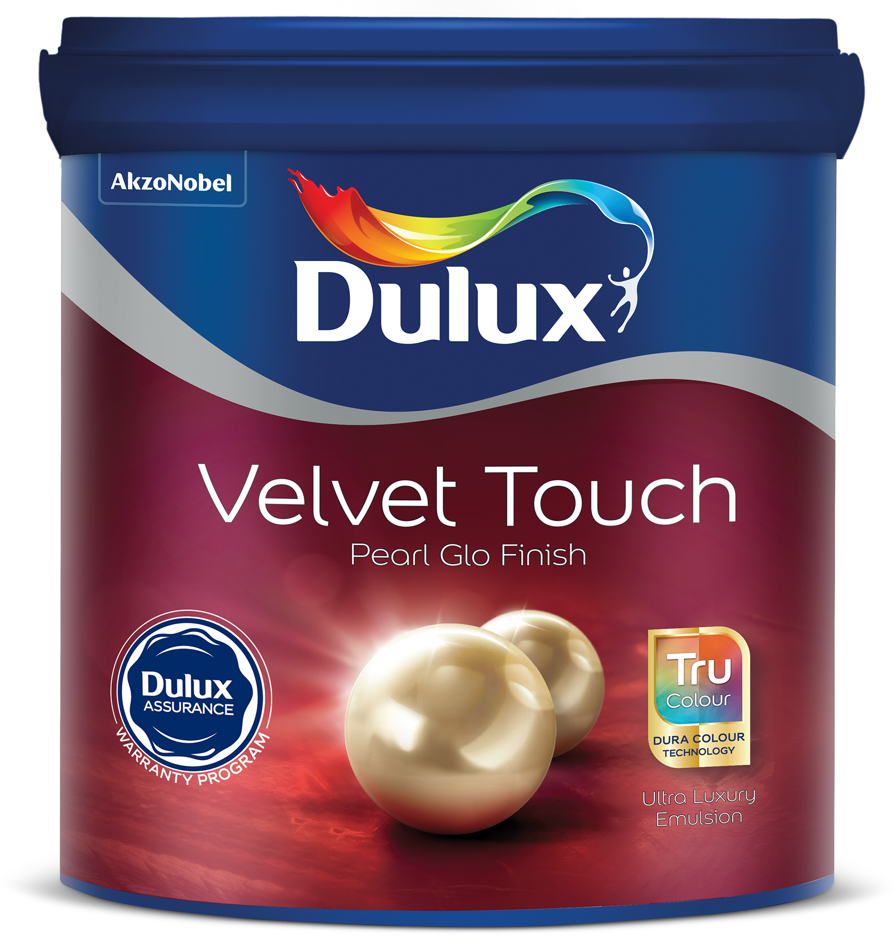
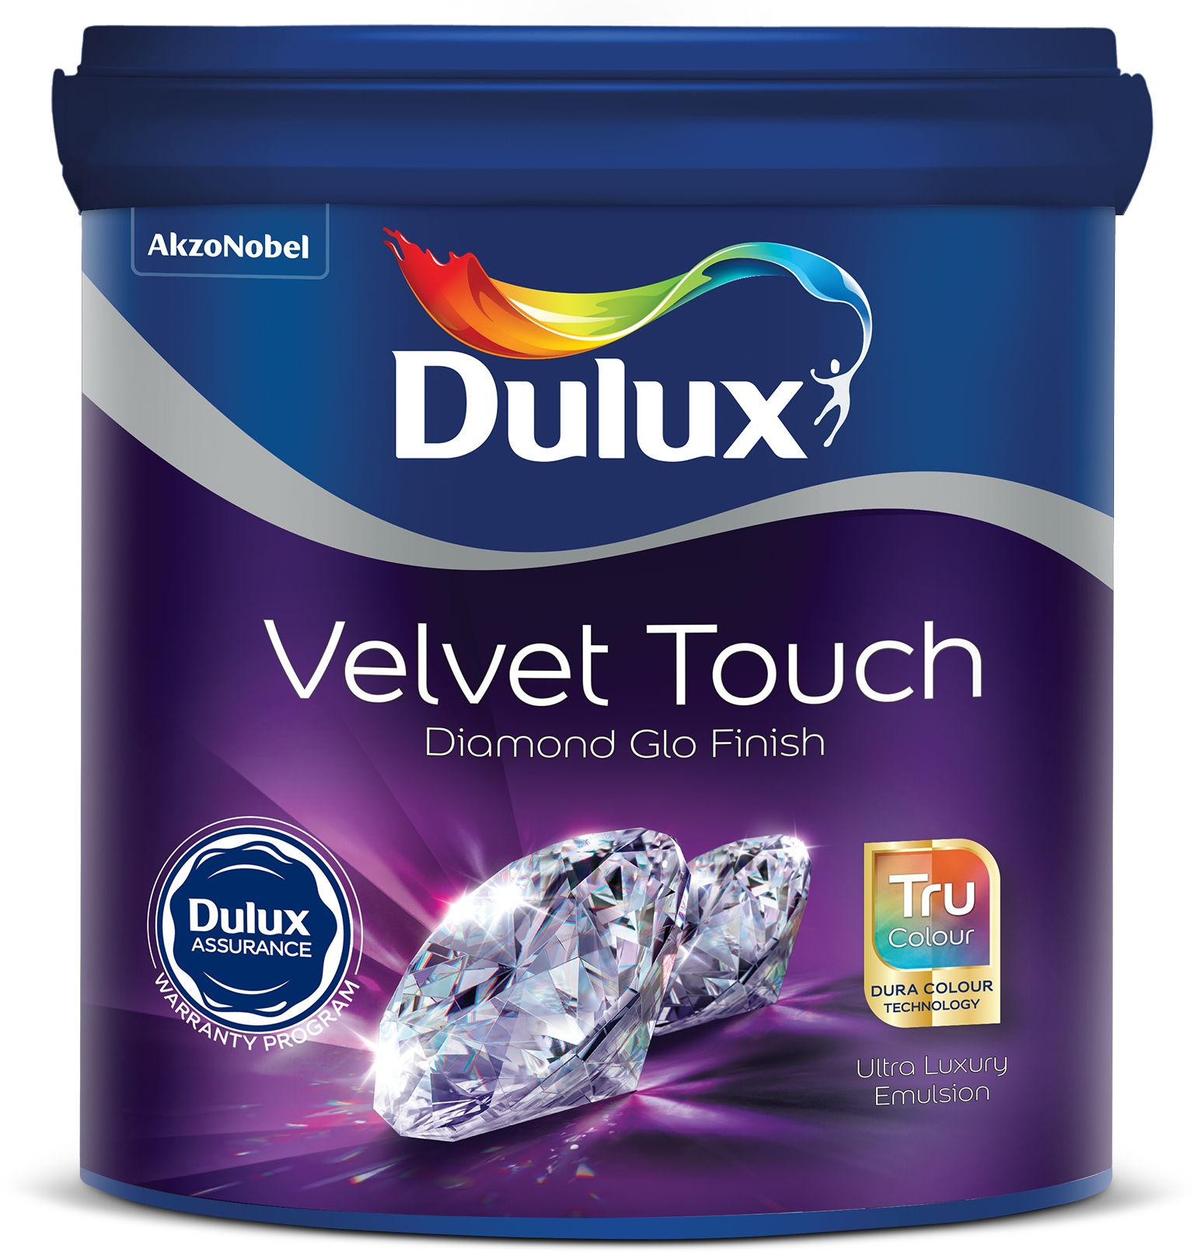
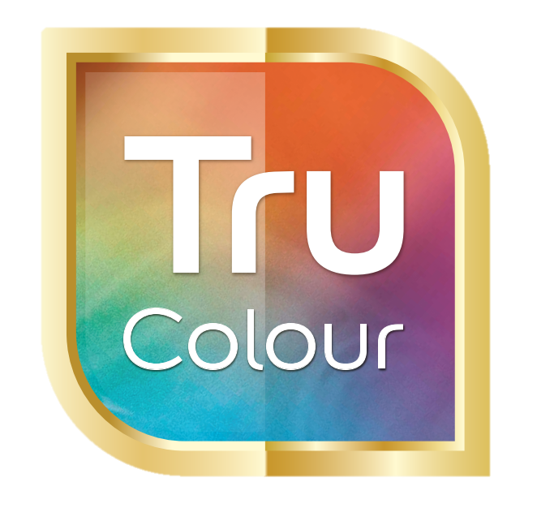




Dulux Velvet Touch
Problem Statement
My home is a reflection of my refined choices in life. I like to do it in a way that mirrors my taste and style and brings alive the luxuriousness. Wall paint forms a very essential part of how I do up my home. I like brands that have rich lineage associated with them and stand for refinedness and elegance
Solution
Dulux Velvet Touch with Tru Color technology provides intense rich colours and ultra smooth finish.
Benefits
Ultra Smooth Finish Rich Intense Colors
Available in
1L, 4L, 10L, 20L
Core & Shell technology
Best in class smoothness
Scrub Resistance
Anti-bacterial & anti-fungal
Product Features
Finish | Smooth finish
Coverage | 12-14 m²/L
Opacity | High
Colour Availability | 2000+
Washability | Superior
Colour Fastness | Best in Class
Mould & Fungus Protection | Superior
Durability | Long lasting
Other benefits:
Anti fungal
Anti-bacterial

Slide 4
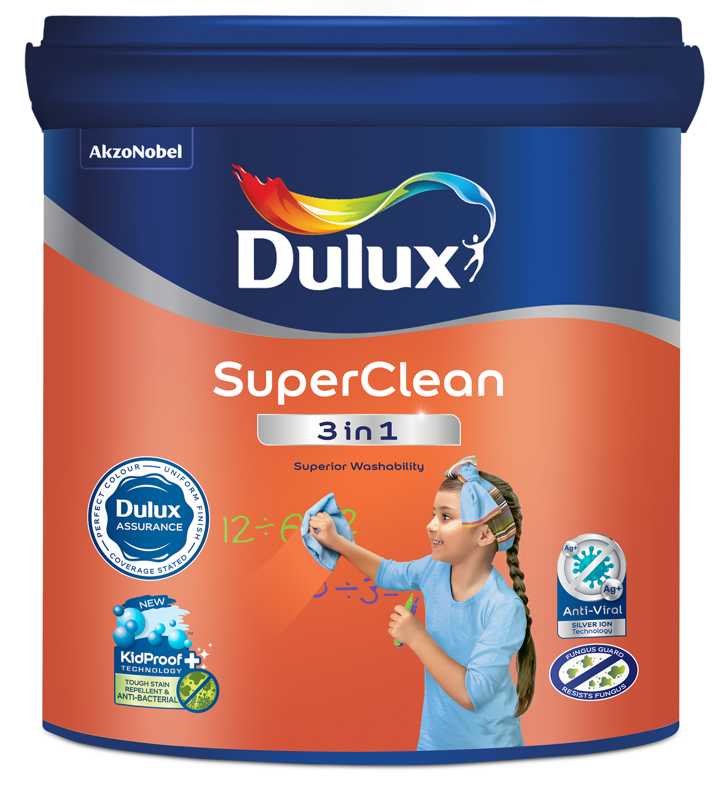
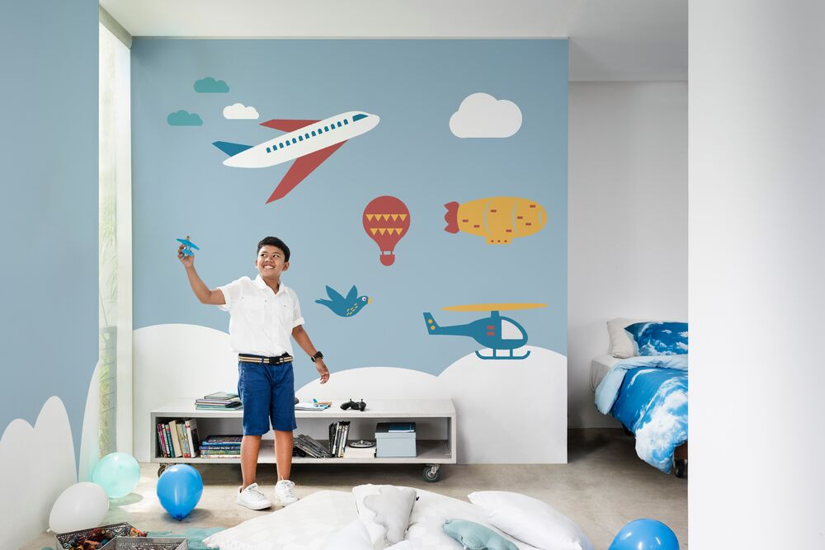
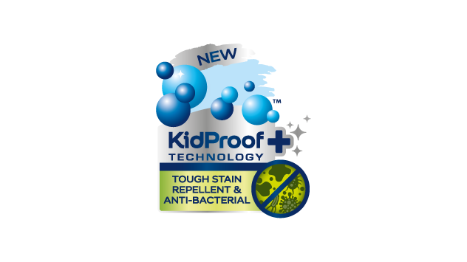
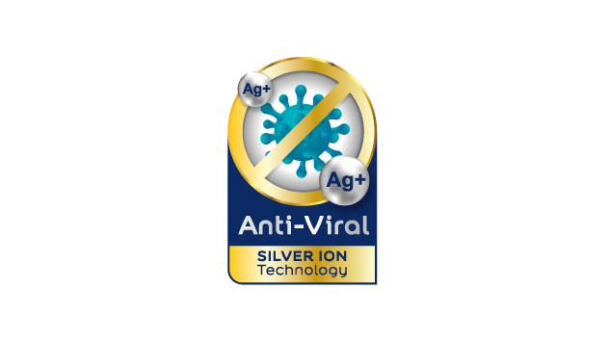
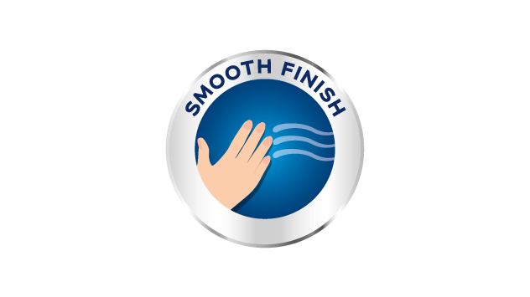
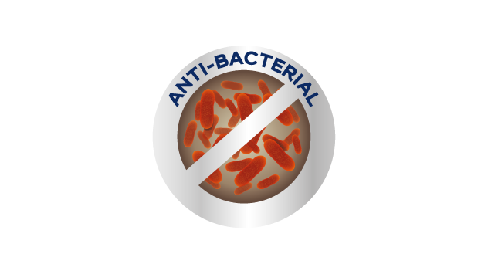
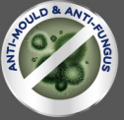
Dulux SuperClean 3in1
Problem Statement
When painting a room, I want my walls to look good and stand the test of time however I know that daily life will eventually take its toll on them
Solution
Dulux SuperClean 3in1 with its unique Kidproof+ technology, that delays stains from penetrating and can be easily wiped away, leaving walls looking fresh and clean
Benefits
Good looking walls with added germ protection that keep your walls looking sparkling clean and fresh, for a long time
Available in
1L, 4L, 10L & 20L
Product Features
Finish | Smooth finish
Coverage | 12-14 m²/L
Opacity | High
Colour Availability | 2077
Washability | Best in Class
Colour Fastness | Superior
Mould & Fungus Protection | Superior
Durability | Long lasting
Other benefits:
Anti fungus
Anti Mould
Low Odour / VOC

Slide 5
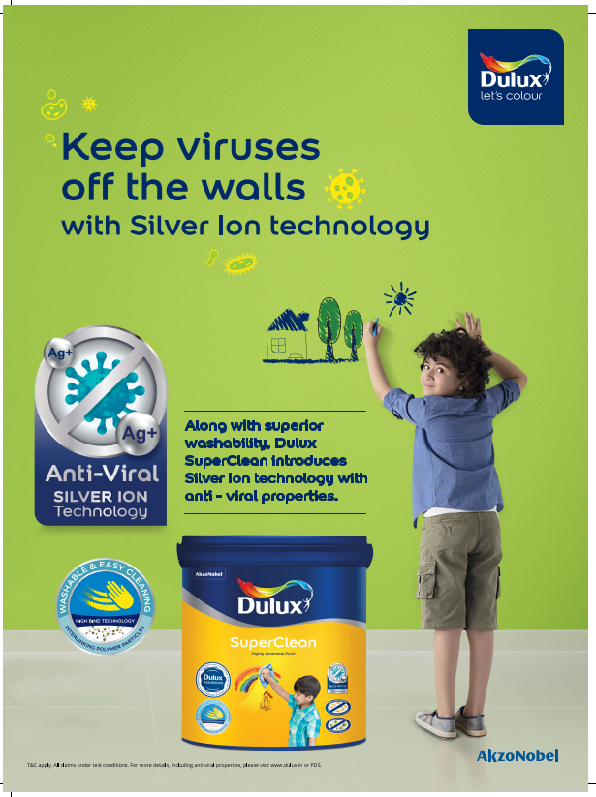
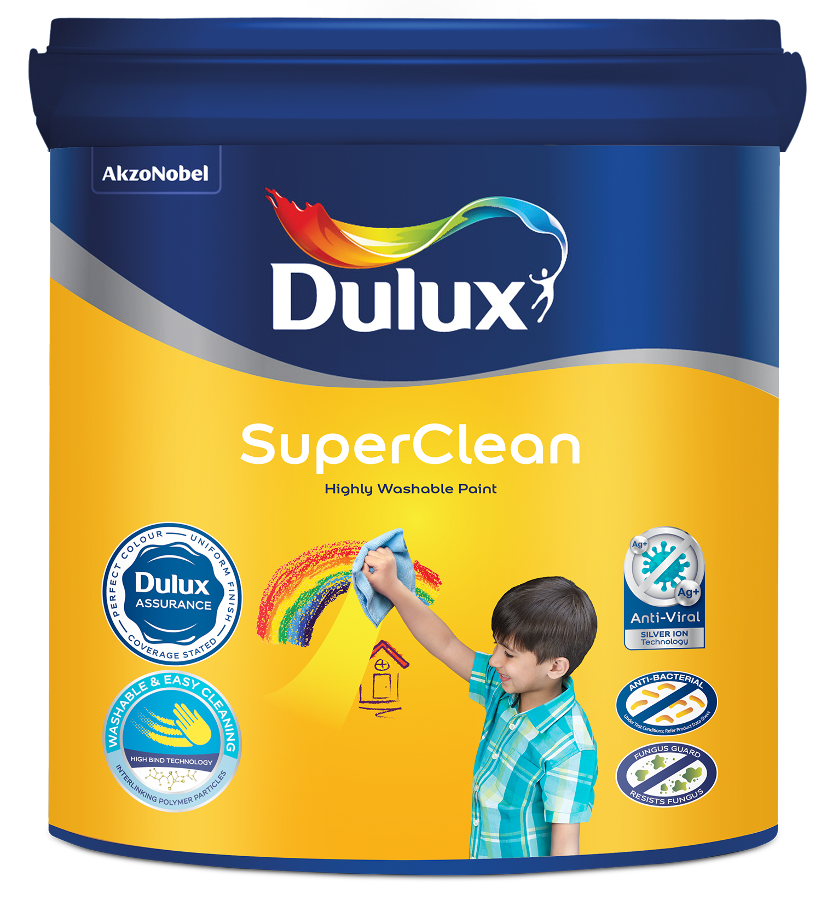
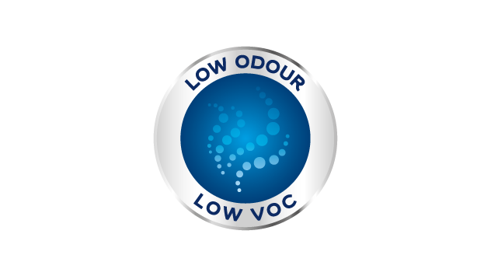

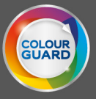
Dulux SuperClean
Problem Statement
I want my walls to look beautiful, but I know that they can be easily spoiled by stains and marks, that remain even after cleaning
Solution
Dulux SuperClean has high washability that combines with ColourGuard technology, to provide walls that look good and withstand normal stains that can be easily cleaned
Benefits
Clean walls, that can withstand tough stains and are easily washable, leaving the walls spotlessly clean
Available in
1L, 4L,10L & 20L
Product Features
Finish | Smooth finish
Coverage | 12-14 m²/L
Opacity | High
Colour Availability | 2000+
Washability | Superior
Colour Fastness | Superior
Mould & Fungus Protection | Superior
Durability | Long lasting
Other benefits:
Anti fungus
Anti Mould
Low odour / VOC

Slide 6
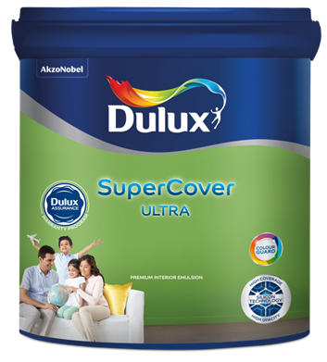
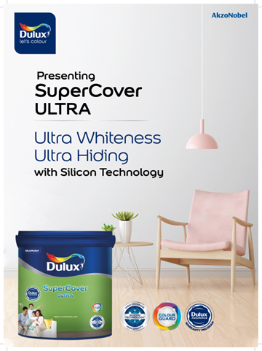

Dulux SuperCover Ultra
Problem Statement
My home is my pride and I want it to look the best always. Over time.
Solution
Dulux SuperCover Ultra is a smooth premium interior emulsion for walls & ceilings that enables you to bring home the long-lasting colors. It’s Silicon technology and Color guard technology ensures that these colors are protected from daily wear & tear and last longer while providing high whiteness and hiding
Benefits
Long Lasting paint with ultra-Whiteness and hiding
Available in
1L, 4L, 10L,20L
Product Features
Finish | Smooth finish
Coverage | 12-14 m²/L
Opacity | High
Colour Availability | 2000+
Washability | Good
Colour Fastness | Good
Mould & Fungus Protection | Best in Class
Durability | Long lasting
Other benefits:
Anti fungus
Anti Mould
Low odour / VOC

Slide 7
EXTERIOR WALL PAINTS

Slide 8
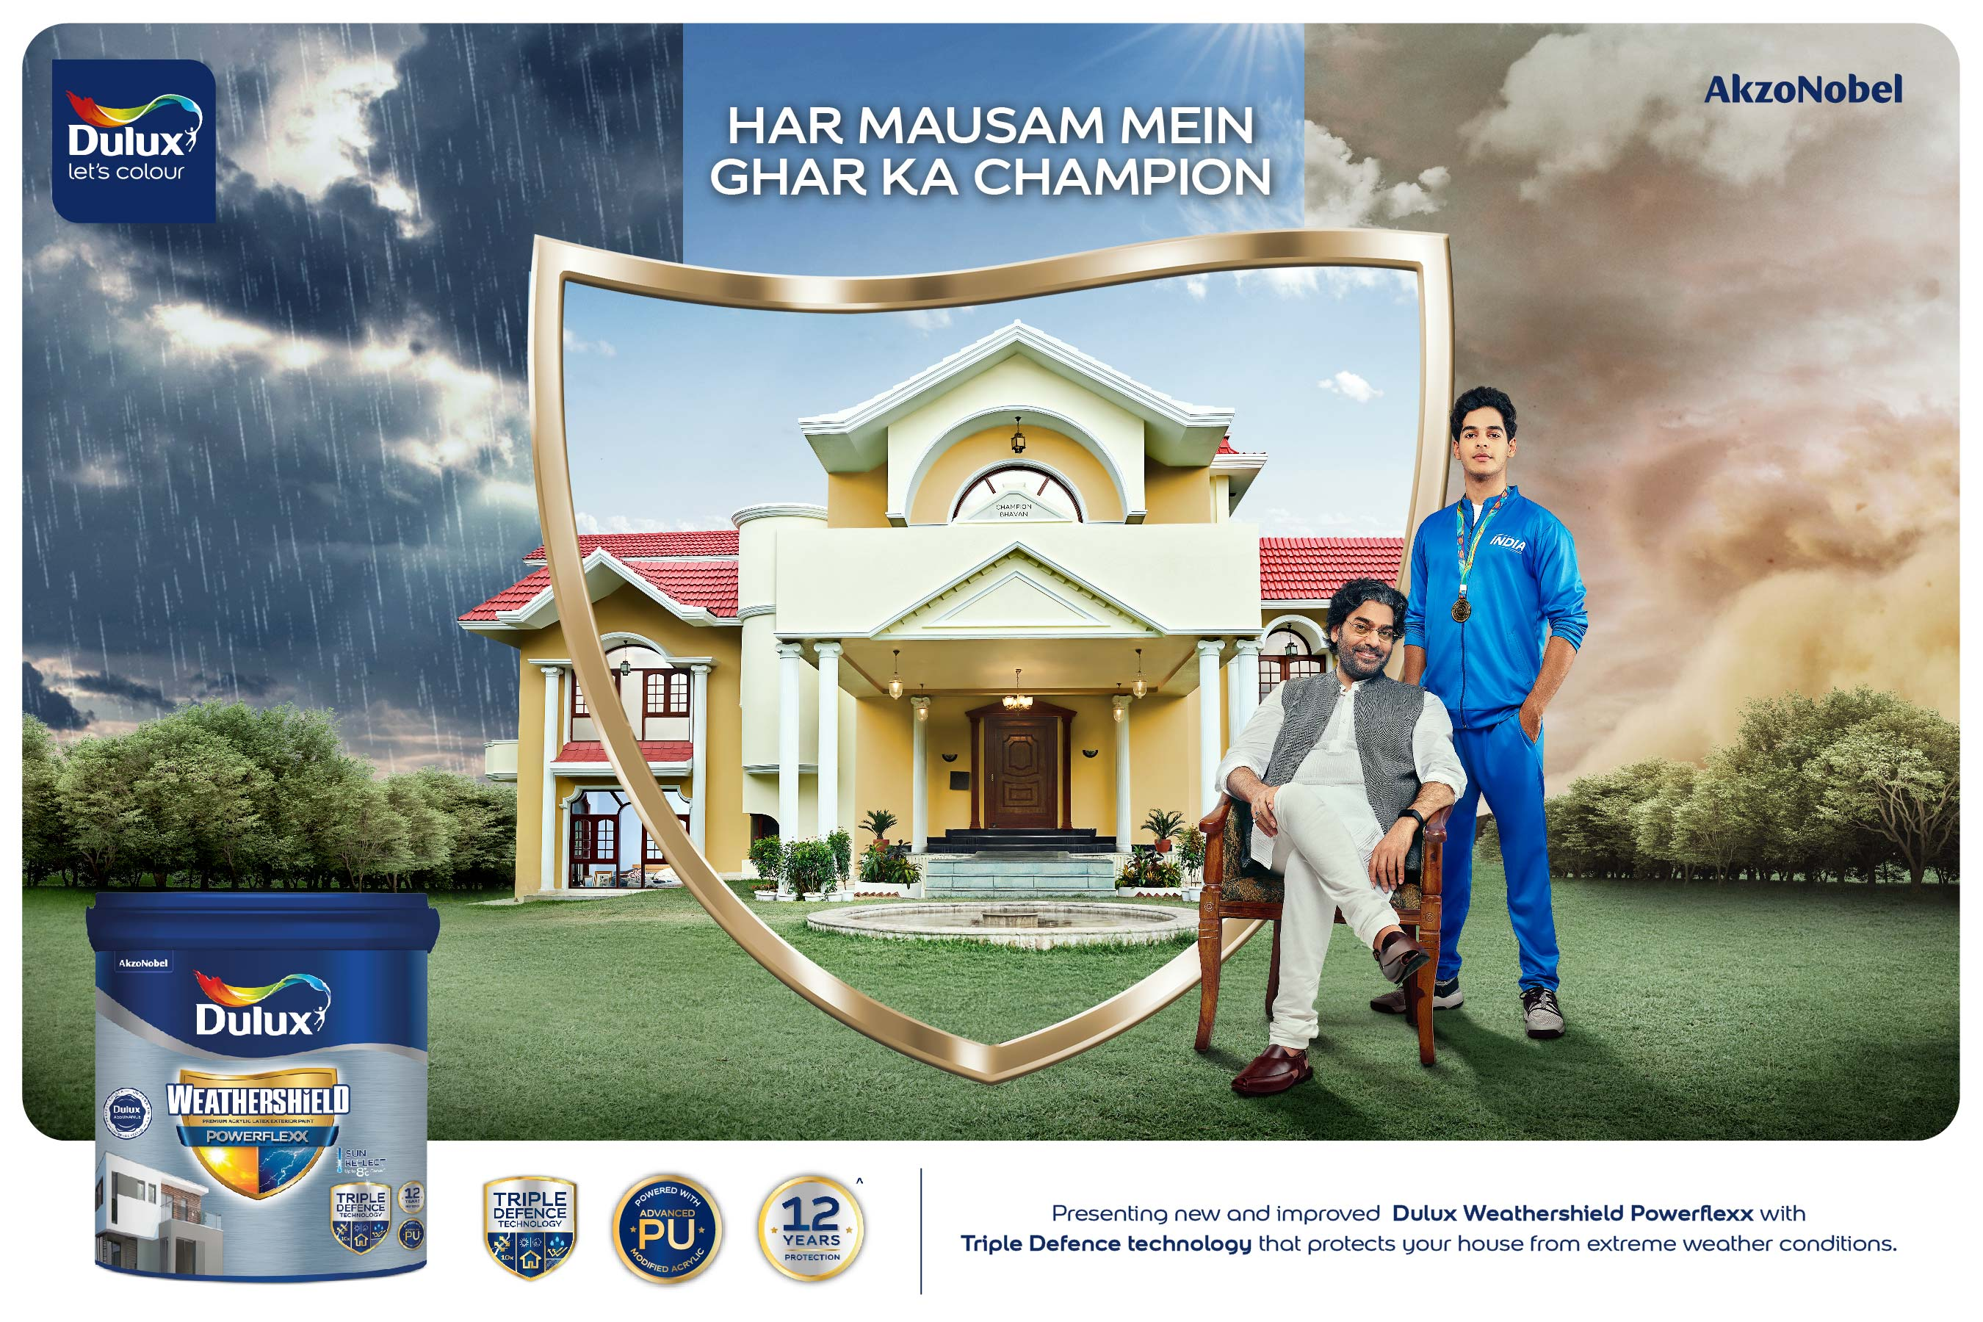
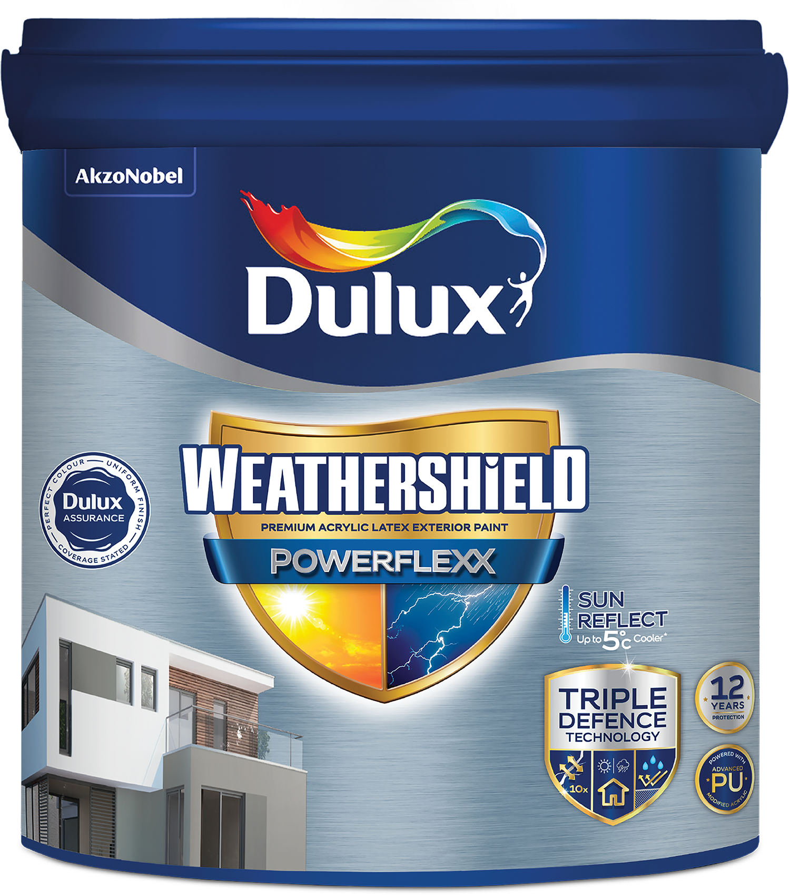
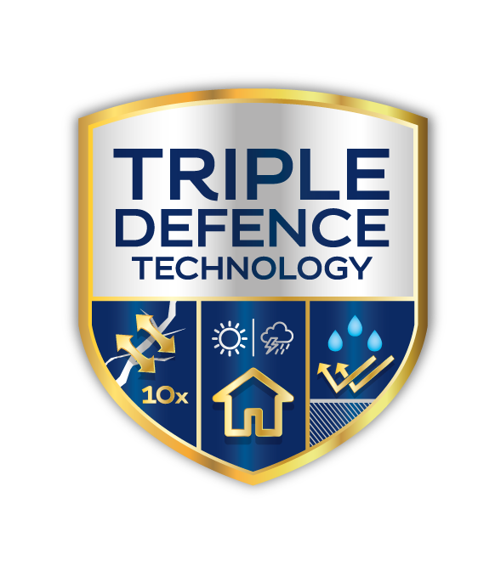
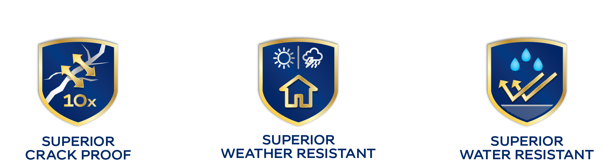
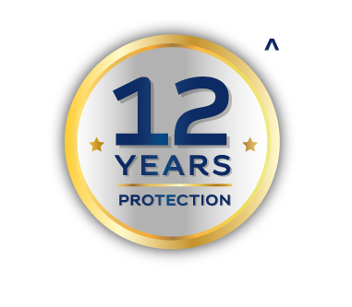
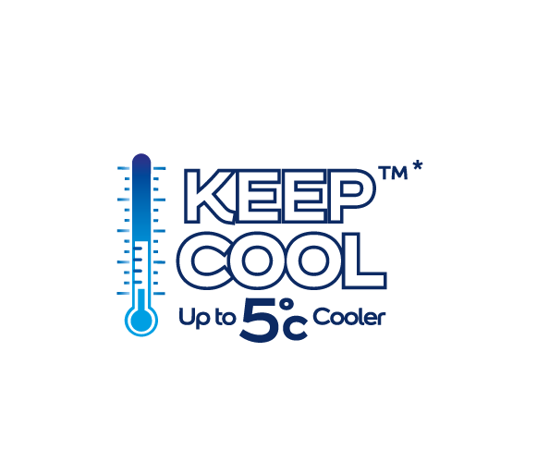
Dulux Weathershield Powerflexx
Problem Statement
My house is a symbol of my success, a pristine looking house fills me with pride. But constant rain and sun causing cracks on the walls, when water seeps through these cracks, it causes further damage to the structure. I want to give my house the best possible protection.
Solution
Dulux Weathershield Powerflexx with its Triple Defence Technology, provides ultimate crack proof, water repellent and ultimate weather resistant for your home. DWS Powerflexx is an elastomeric paint comes with thick and tough yet highly stretchable paint film, it covers 10x wider crack than normal paints, water repellent and weather resistant.
Benefits
A long lasting beautiful home free from cracks, algae & fungus, dirt & water marks, colour fading, alkali and with 12 years of warranty.
Available in
1L, 4L, 10L, 20L
Superior
CrackBridging
Superior
Weather Resistance
Superior
Water Resistance
Product Features
Finish | Sheen Finish
Coverage | 10-12 m²/L
Opacity | Superior opacity
Colour Availability | 3258 Tinting
Colour Protection | High colour protection
Algae & Fungus Protection | Excellent protection
Alkali Resistance | Superior resistance
Durability / Warranty | 12 years
Other benefits:
Low VOC / Low Odour
No Added Lead & mercury

Slide 9
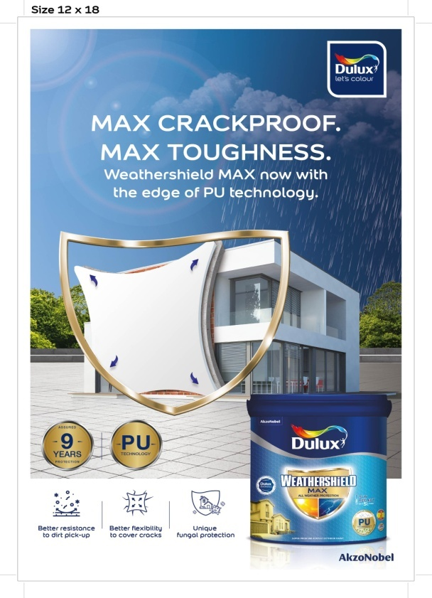
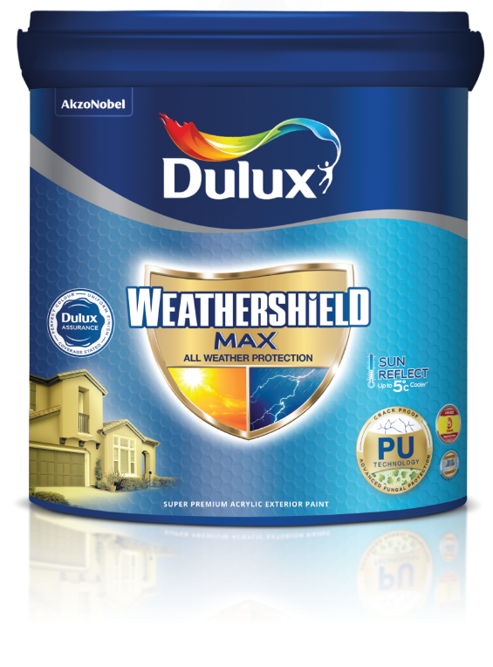
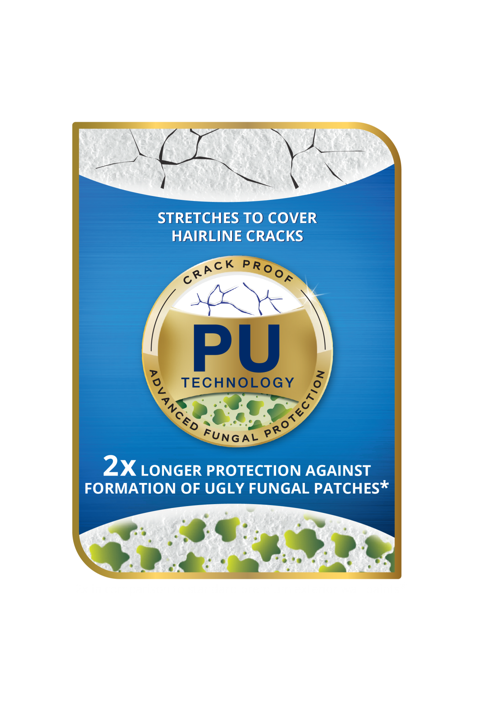

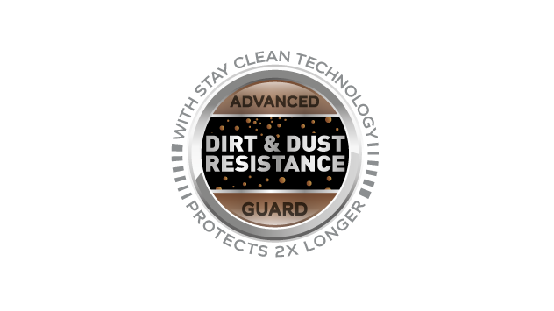
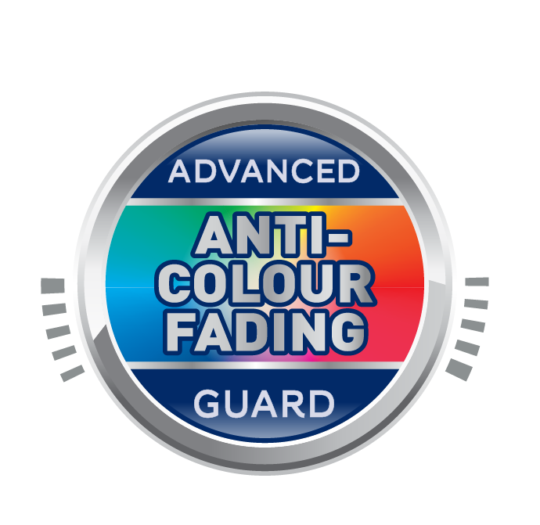
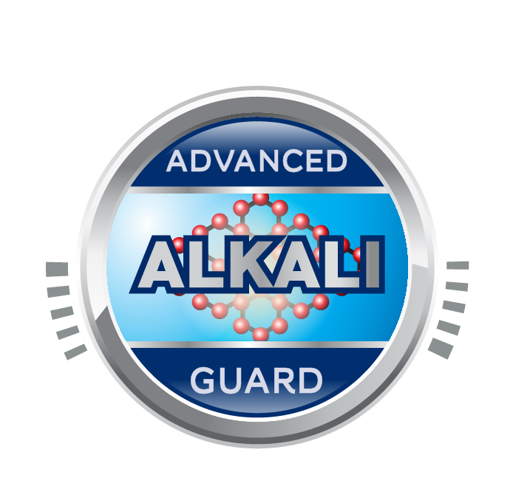
Dulux Weathershield Max
Problem Statement
My house is a symbol of my success, a pristine looking house fills me with pride. But constant rain and sun causing cracks on the walls, when water seeps through these cracks, it causes further damage to the structure. I want to give my house the best possible protection.
Solution
Dulux Weathershield MAX with its PU Technology, provides ultimate crack bridging abiligy of upto 0.5mm , Anti Advanced Alkali Guard, water repellent and ultimate weather resistant for your home. DWS MAX is an elastomeric paint comes PU technology which provides tough film with better adhesion, sheen and better DPUR
Benefits
A long lasting beautiful home free from cracks, algae & fungus, dirt & water marks, colour fading, alkali and with 9 years warranty.
Available in
1L, 4L, 10L, 20L
Product Features
Finish | Sheen Finish
Coverage | 10-12 m²/L
Opacity | Superior opacity
Colour Availability | 3258 Tinting
Colour Protection | High colour protection
Algae & Fungus Protection | Excellent protection
Alkali Resistance | Superior resistance
Durability / Warranty | 9 years
Other benefits:
Low VOC / Low Odour
No Added Lead & mercury

Slide 10
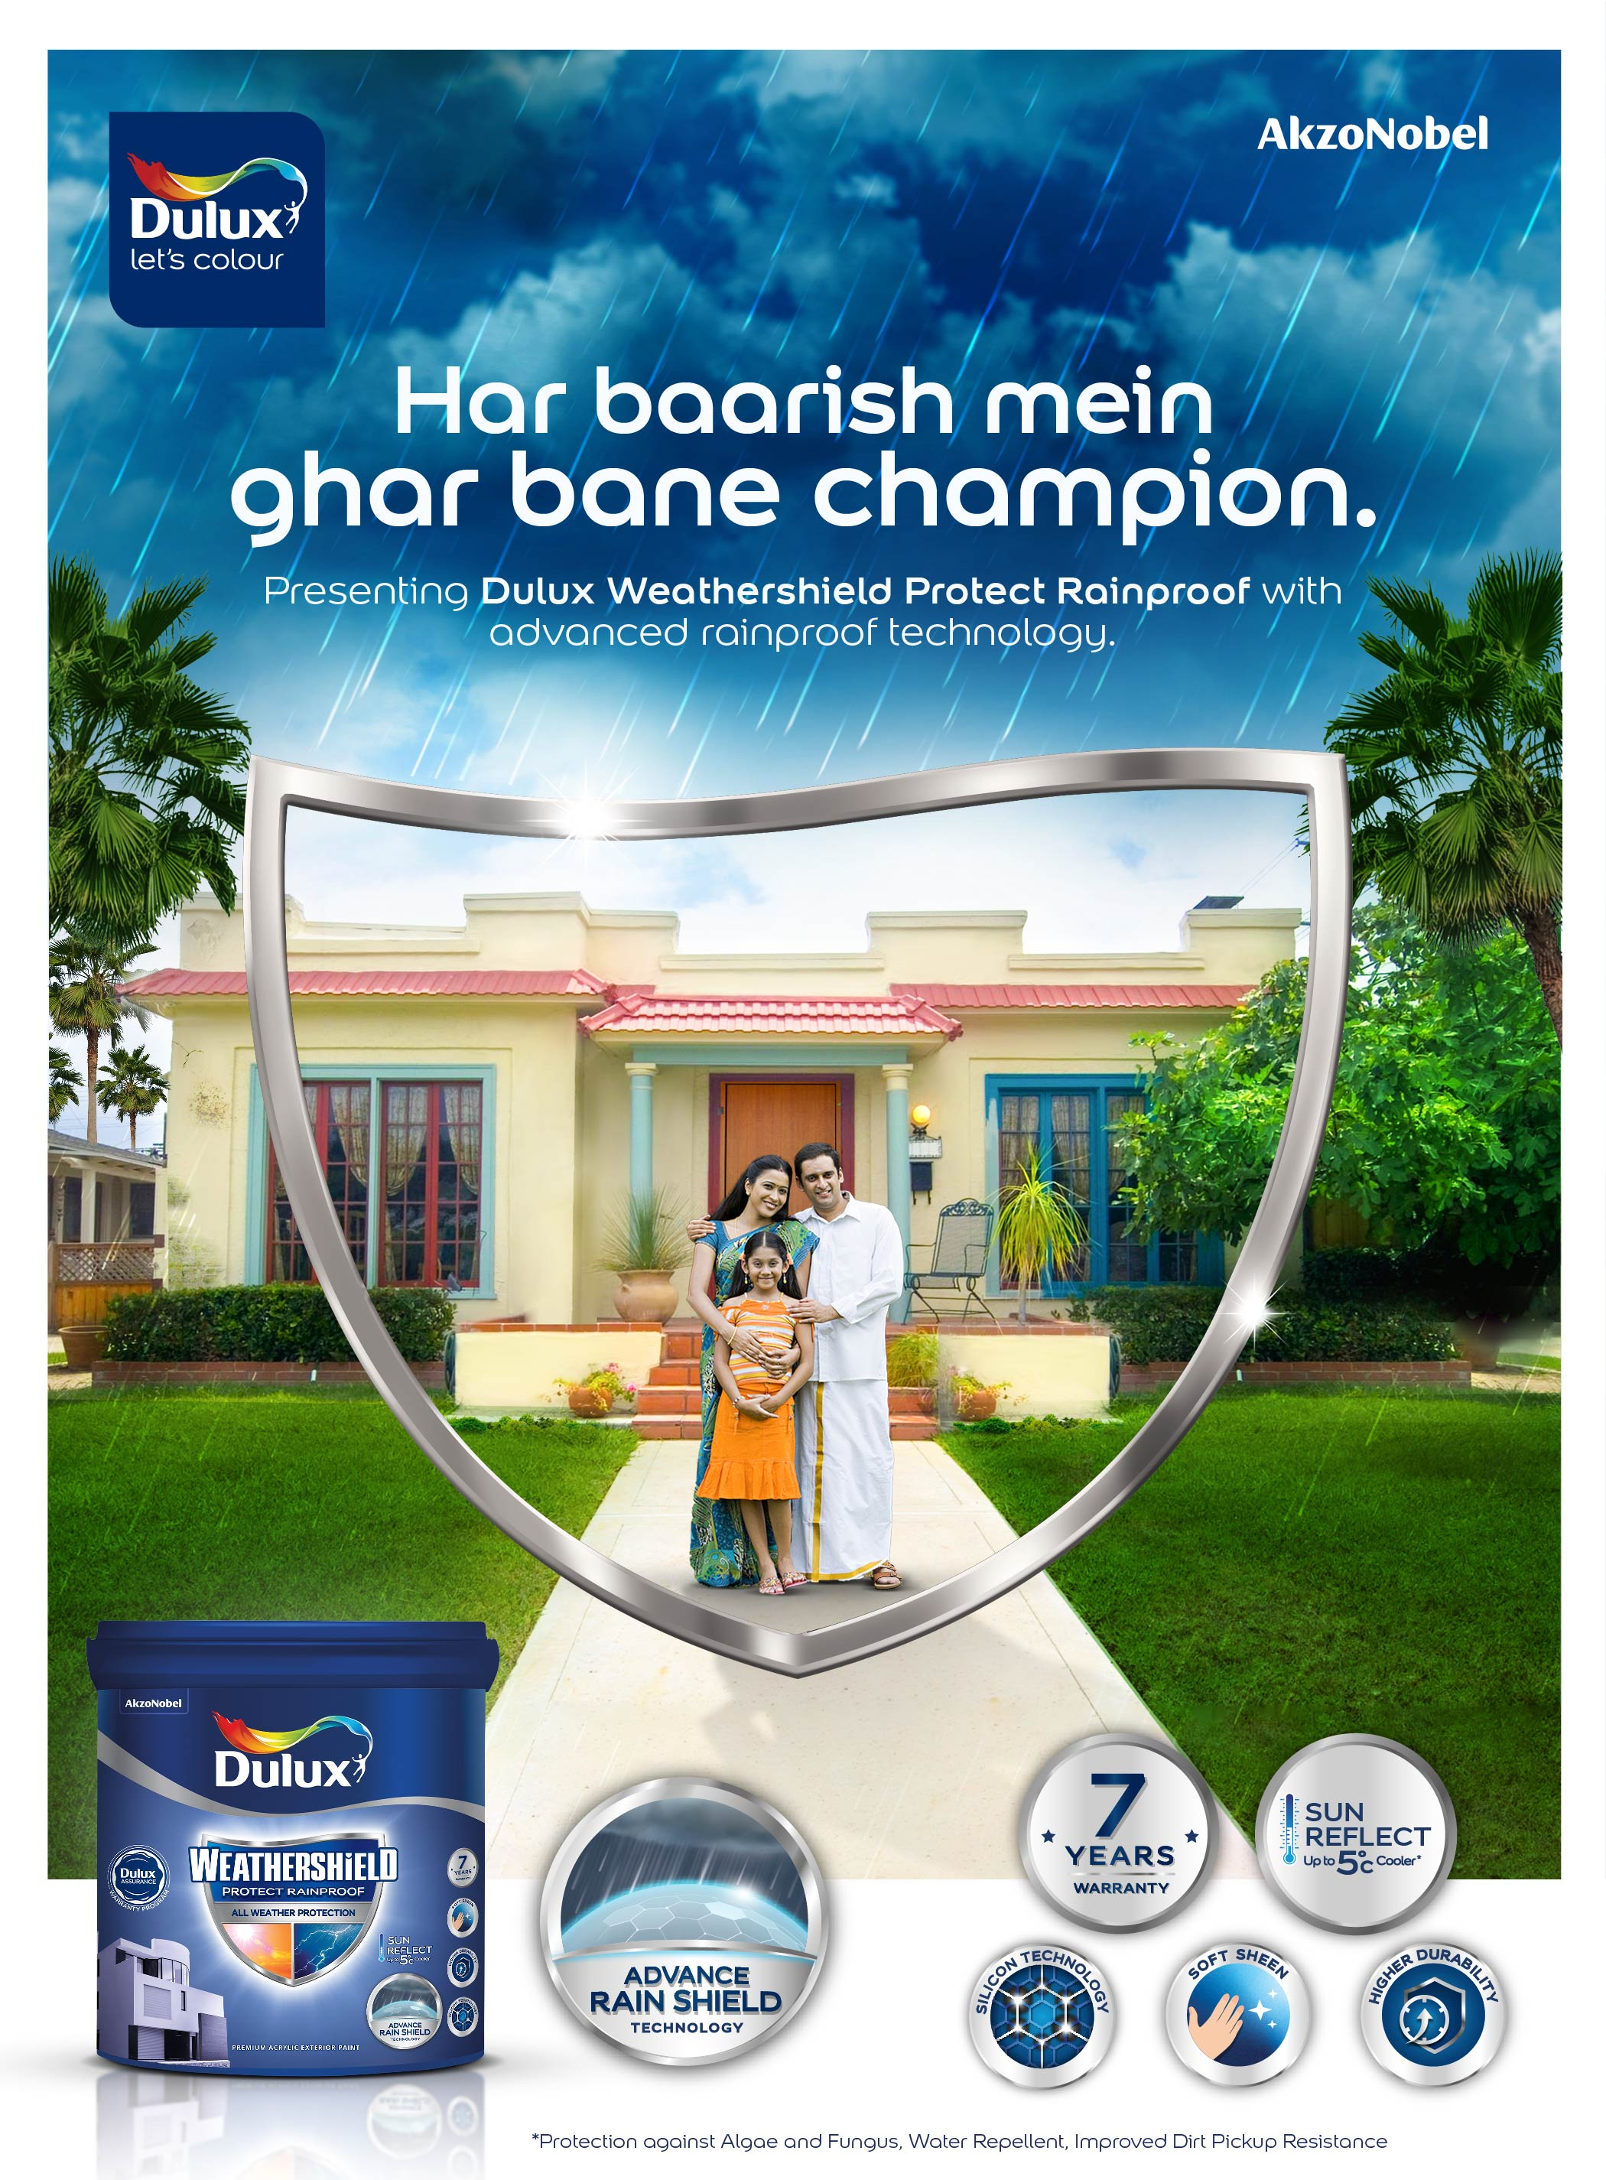
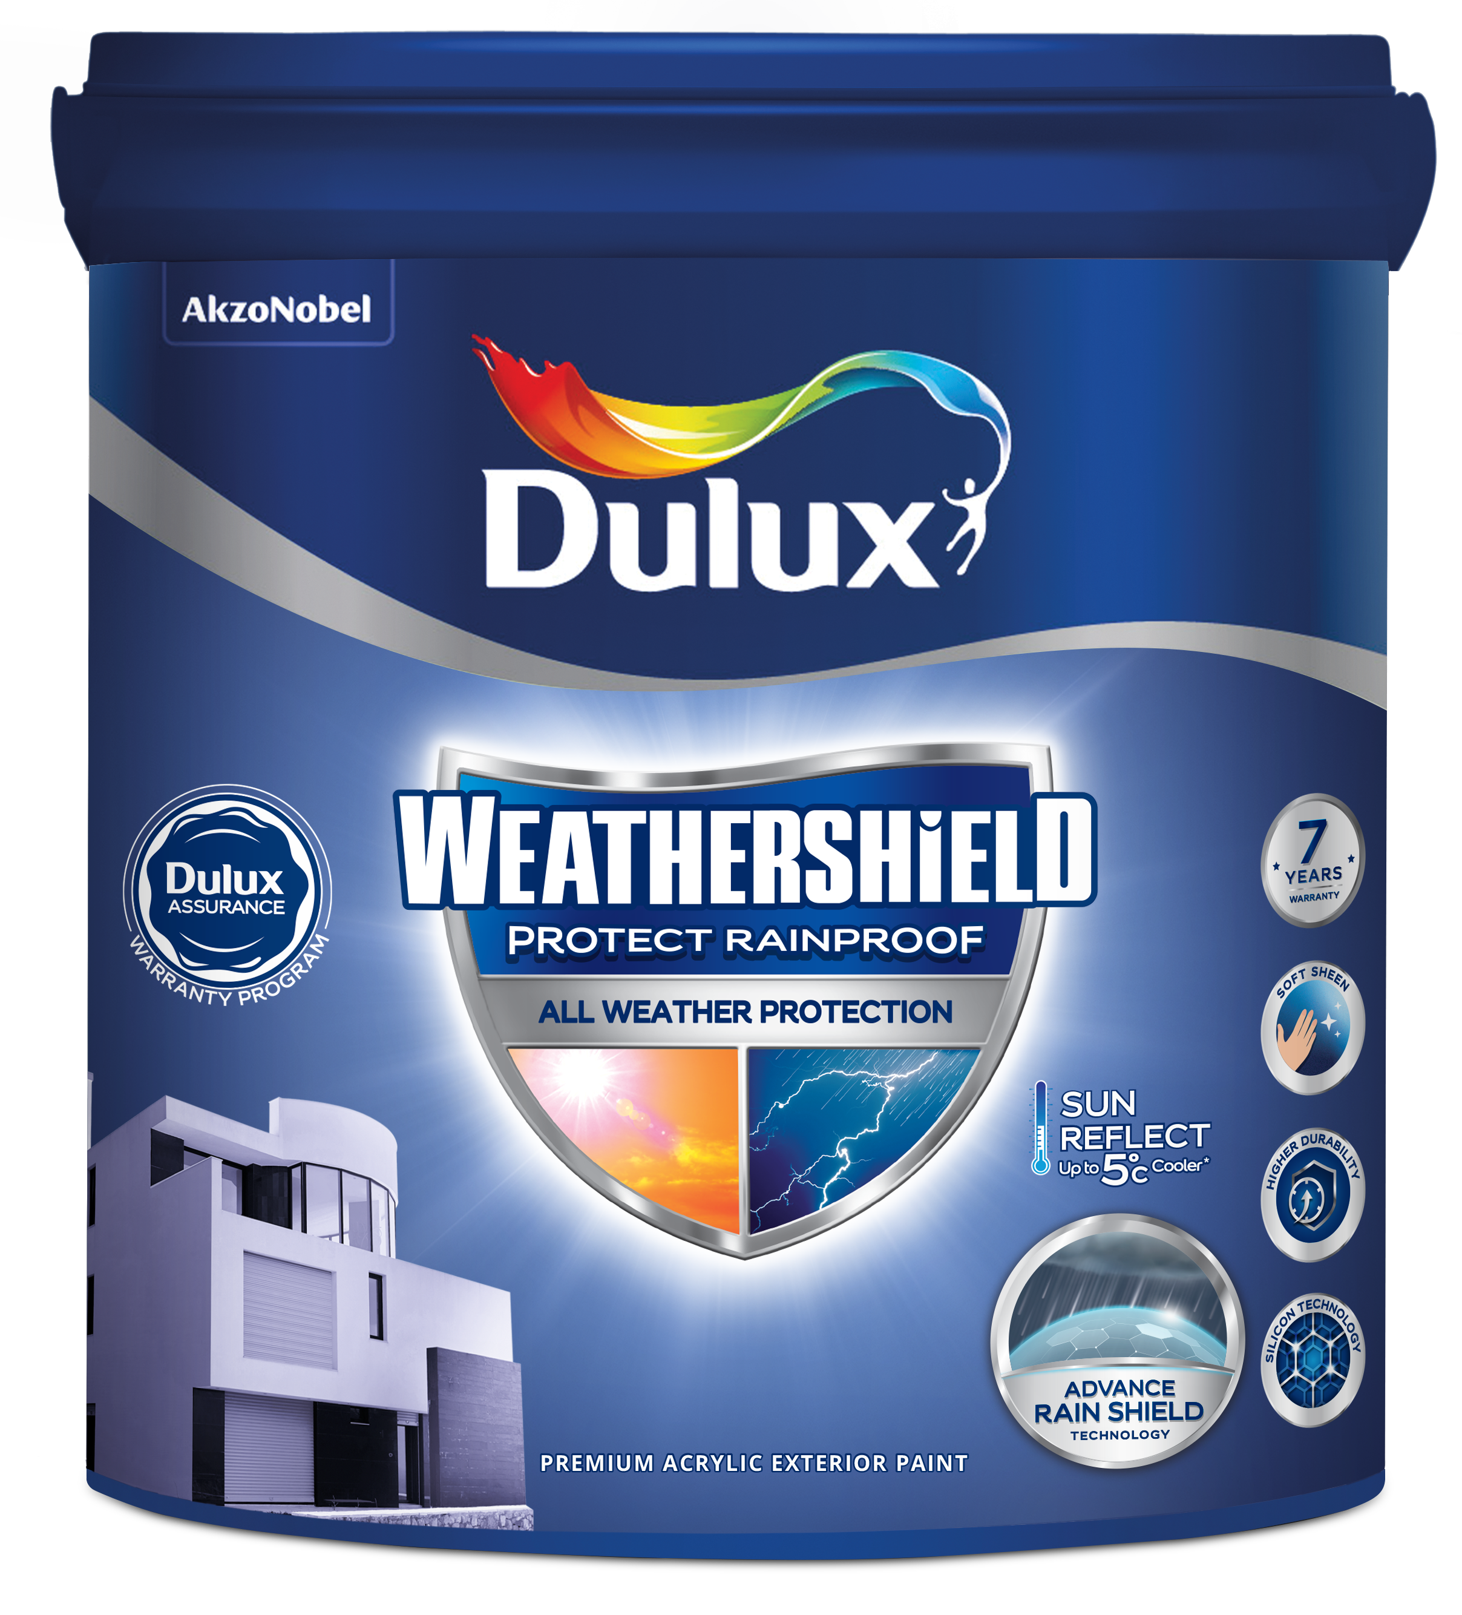
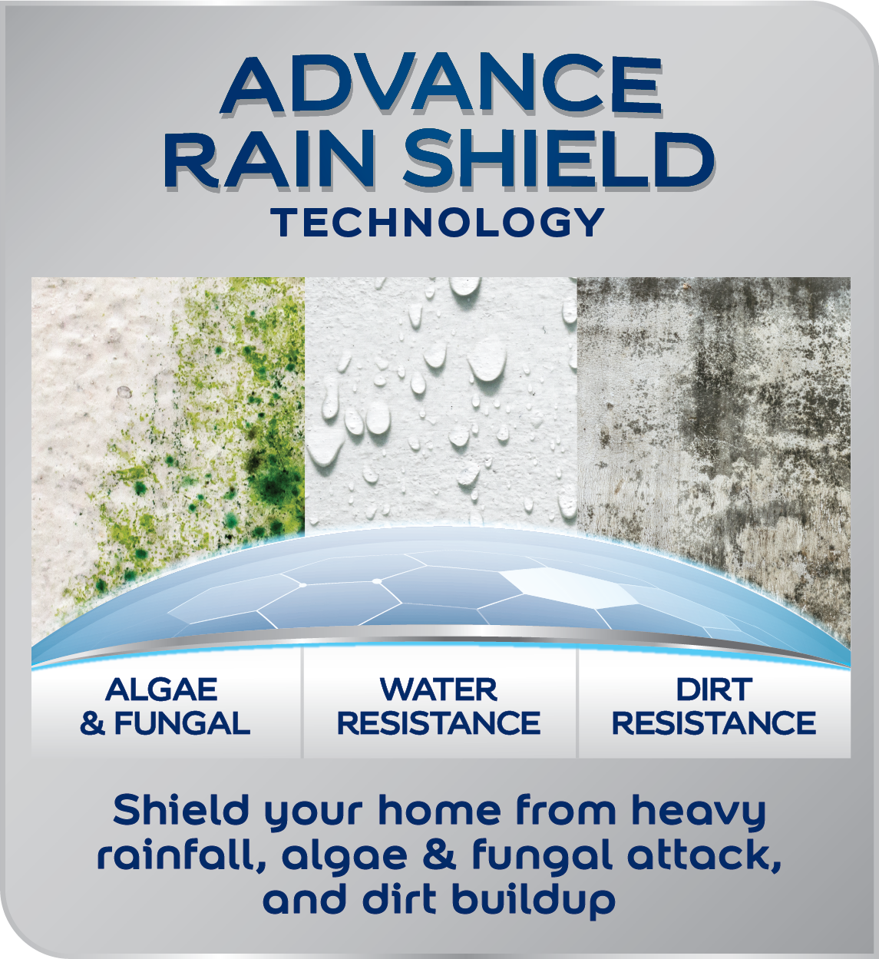




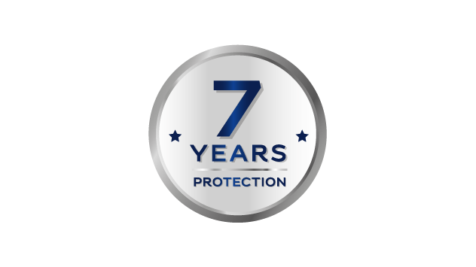
Dulux Weathershield Rainproof
Problem Statement
My home is a symbol of my success, a pristine-looking house fills me with pride. Harsh weather and air pollution make the exterior walls of my home look old and dirty sooner than expected. I wish for an exterior paint that would keep my house looking clean and fresh for longer.
Solution
Dulux Weathershield Protect Rainproof , with its Advance Rainshield Technology, provides protection against Algae and Fungal , provides Water Resistance and Dirt Resistance. Its silicon Technology provides higher durability to the film which protects the house for upto 7 Years . The product comes with Soft sheen.
Benefits
Cleaner, brighter and fresher home with Advance Rainshield Technology against high rainfall comes with 7 years warranty.
Available in
1L, 4L, 10L,20L
Product Features
Finish | Low Sheen Finish
Coverage | 12-13 m²/L
Opacity | High opacity
Colour Availability | 3258 Tinting
Colour Protection | High colour protection
Algae & Fungus Protection | High protection
Alkali Resistance | High resistance
Durability / Warranty | 7 years
Other benefits:
Low VOC / Low Odour
No Added Lead & mercury

Slide 11
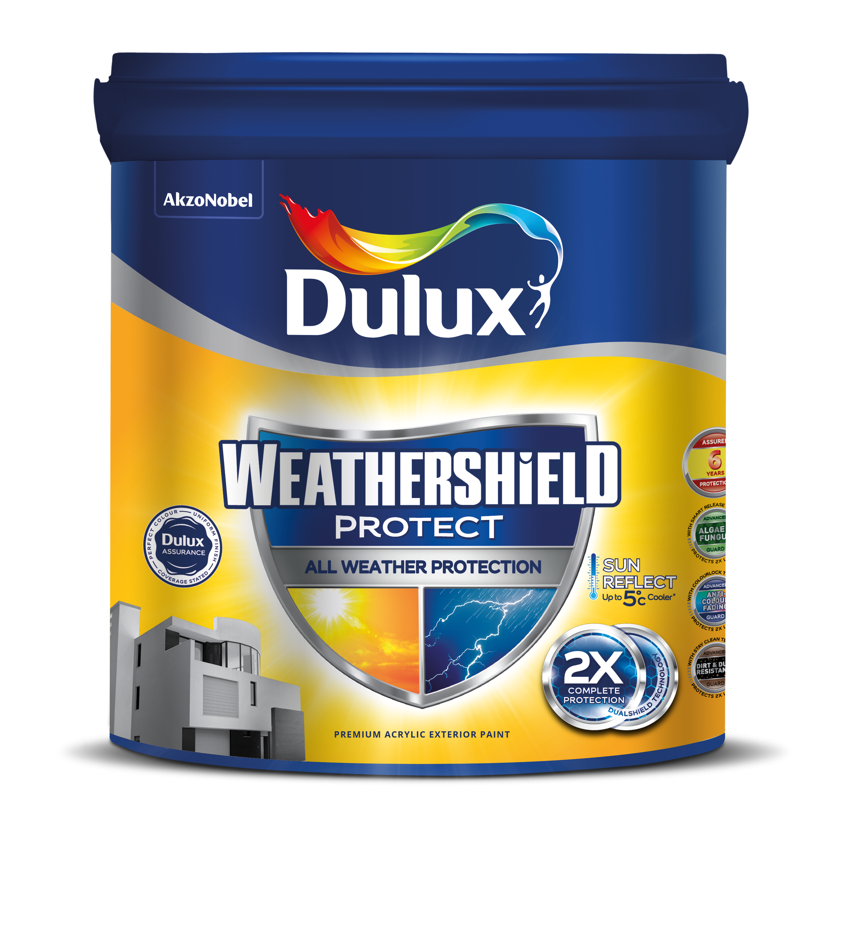
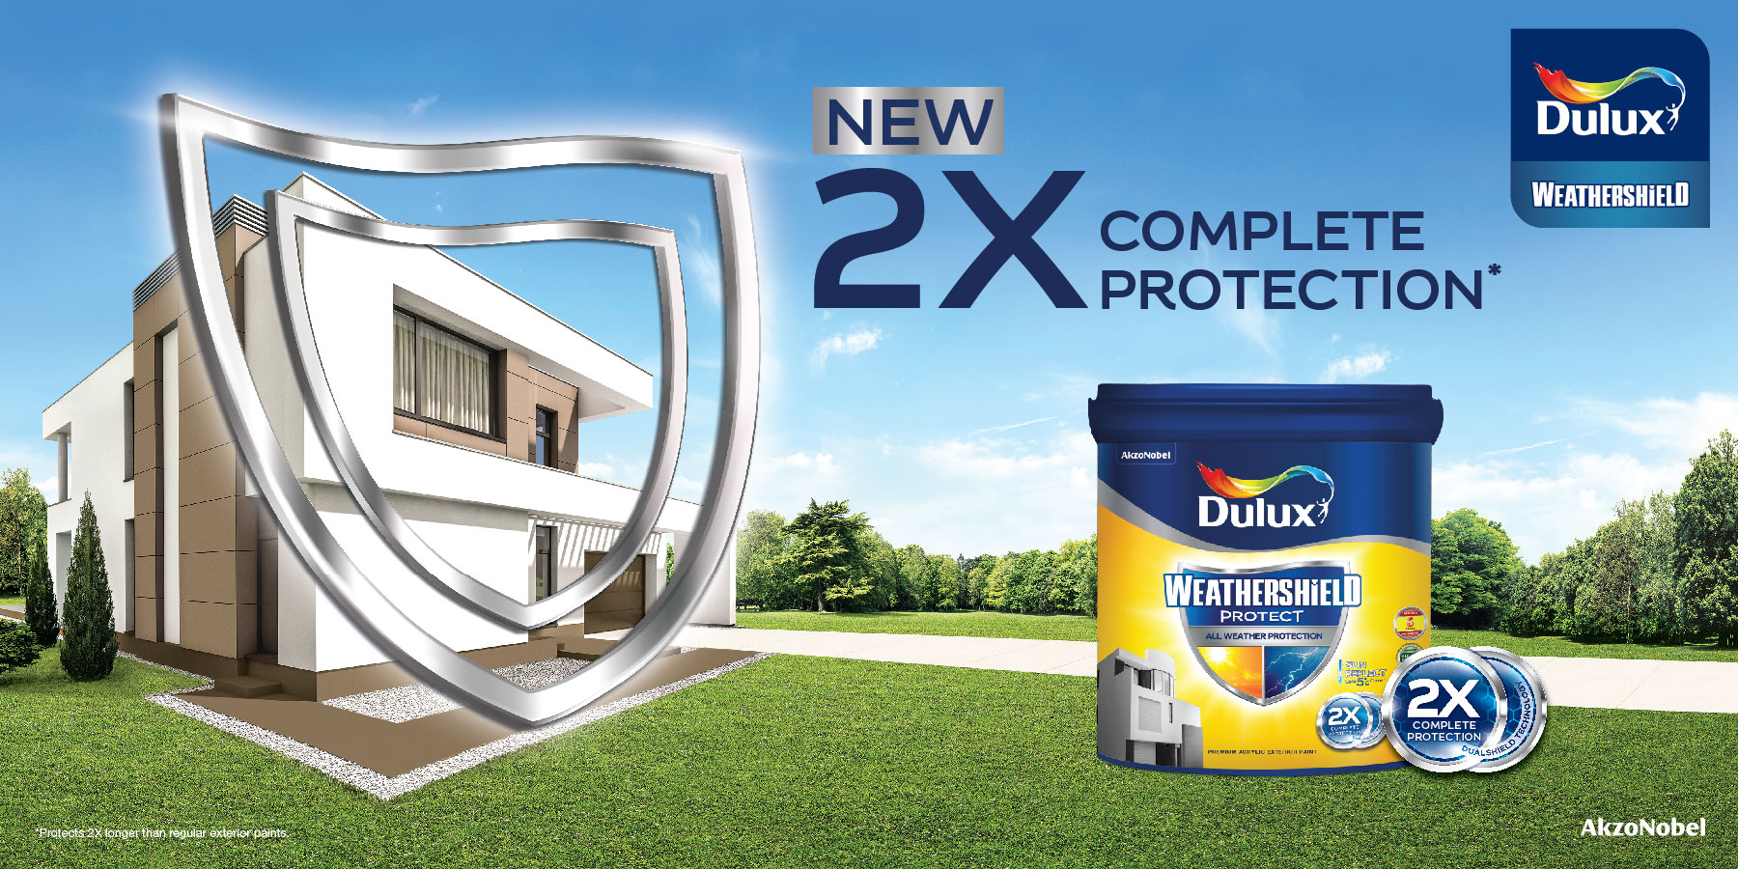
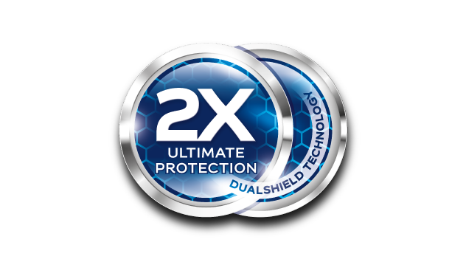
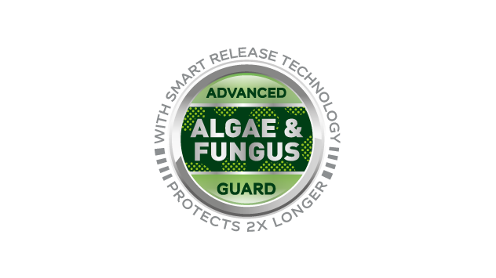
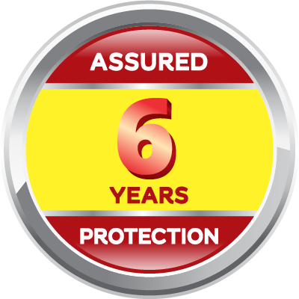
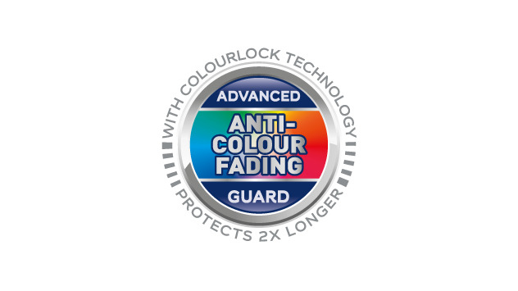
Dulux Weathershield
Problem Statement
My home is a symbol of my success, a pristine-looking house fills me with pride. Harsh weather and air pollution make the exterior walls of my home look old and dirty sooner than expected. I wish for an exterior paint that would keep my house looking clean and fresh for longer.
Solution
Dulux Weathershield, with its Dualshield™ Technology, provides 2x* longer protection against colour fadingi, dirt and dust deposits and algae & fungus.
Benefits
Cleaner, brighter and fresher home with 2X Ultimate Protection against all weather with Dulux Weathershield, comes with 6 years of protection assurance.
Available in
1L, 4L, 10L, 20L
Product Features
Finish | Low Sheen Finish
Coverage | 12-13 m²/L
Opacity | High opacity
Colour Availability | 5 Ready Mix , 3258 Tinting
Colour Protection | High colour protection
Algae & Fungus Protection | High protection
Alkali Resistance | High resistance
Durability / Warranty | 6 years
Other benefits:
Low VOC / Low Odour
No Added Lead & mercury

Slide 12
WATERPROOFING

Slide 13
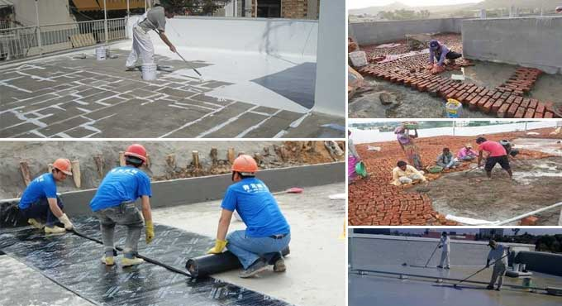
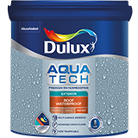
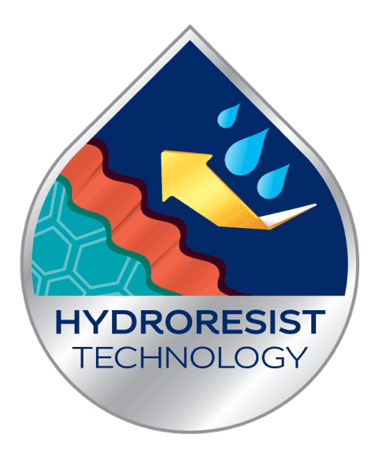
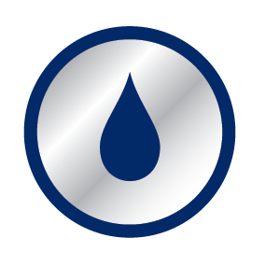


Liquid Applied Horizontal - Dulux Aquatech Roof WTP
Problem Statement
Our house is our pride and biggest investment, built to last for generations. In our humid climate dampness and water seepage impacts the structure and safety of our house. How can I prevent water leaking & seepage on horizontal exterior roofs/terraces? I need a thorough and long lasting solution to get the dampness out and prevent it from coming back
Solution
Dulux Aquatech Roof Waterproof is a premium liquid applied horizontal waterproofing solution which provides protection for roofs & surfaces for up to 8 years. With HydroResist Technology, it forms an impenetrable, tough film up to 600-800 microns over porous roofs / terraces.
Benefits
Stay worry free when it comes to protection of my house from any dampness and seepages issues
Available in
1L, 4L,10L & 20L
Other benefits:
Sun Reflect of up to 10 degree Celsius
Multi-surface adhesion on surfaces like brickbat coba, plaster, china chips and mosaic tiles
Superior WTP Protection
Bridges Cracks
Foot Trafficable
Product Features
Application | Interior & Exterior Durable
Coverage | Up to 0.74-0.92 m2 / L / 3 coats Min. 3 coats (recommended)
Finish | NA
Colour Availability | Ready Mix – White
Waterproofing Substrate | Horizontal
Surface Durability | Prevents water seepage and carbonation
Microorganism Protection | Prevent fungal attacks
Crack Protection | The film being highly flexible, it bridges cracks of up to 2mm
Similar Technology available in PK
(Dulux Aquashield WTP Roof Coat),
TH (Dulux Aquatech Roof Coat),
ID (Dulux Aquatech Max WTP),
VN (Dulux Aquatech Max WTP)

Slide 14
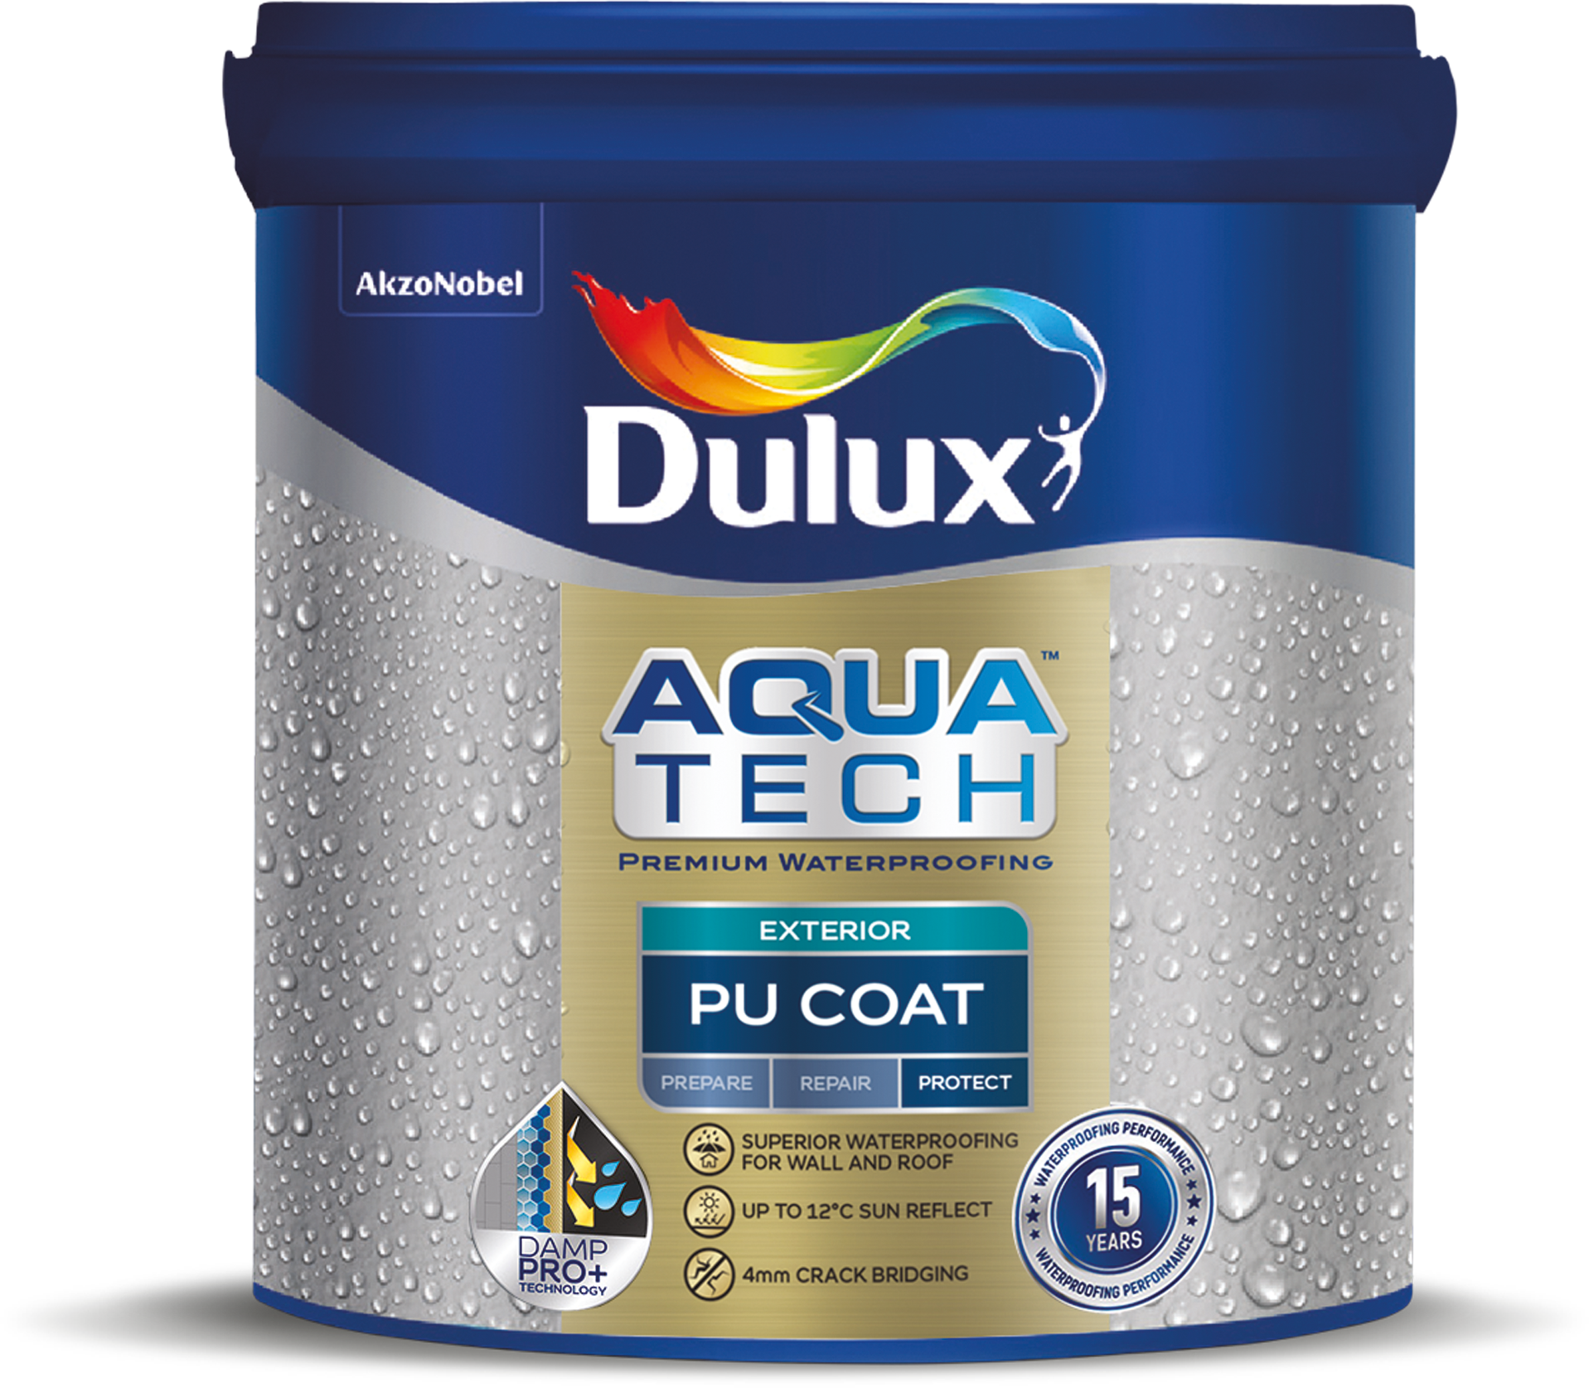



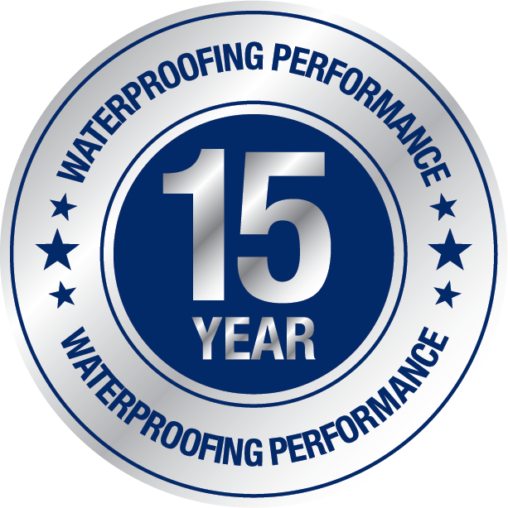
Liquid Applied Horizontal - Dulux Aquatech PU Coat
Problem Statement
Our house is our pride and biggest investment, built to last for generations. In our humid climate dampness and water seepage impacts the structure and safety of our house. How can I prevent water leaking & seepage on both vertical and horizontal exterior surfaces ? I need a thorough and long lasting solution to get the dampness out and prevent it from coming back
Solution
Dulux Aquatech PU Coat is a PU bases elastomeric liquid applied memberane which provides protection the vertical and horizontal surfaces for upto 15 Years With HydroResist Technology, it forms an impenetrable, tough film up to 600-800 microns over porous roofs / terraces and 200-240 microns on vertical surfaces.
Benefits
Stay worry free when it comes to protection of my house from any dampness and seepages issues
Available in
1L, 4L & 20L
Other benefits:
Sun Reflect of up to 12 degree Celsius
Multi-surface adhesion on surfaces like brickbat coba, plaster, china chips and mosaic tiles
Applicable on Podiums and for Terrace gardening
Superior WTP for Wall & Roof
Sun Reflect upto 12 Degrees
4mm Crackbridging
15 Years Warranty
Product Features
Application | Interior & Exterior Durable
Coverage | Up to 0.74-0.92 m2 / L / 3 coats Min. 3 coats for Horizontal surfaces (recommended) Upto 3.71 m2 / L /Coat (Forced Coverage) for vertical surfaces
Finish | NA
Colour Availability | Ready Mix – White
Waterproofing Substrate | Horizontal , Vertical
Surface Durability | Prevents water seepage and carbonation
Microorganism Protection | Prevent fungal attacks
Crack Protection | The film being highly flexible, it bridges cracks of up to 4mm

Slide 15
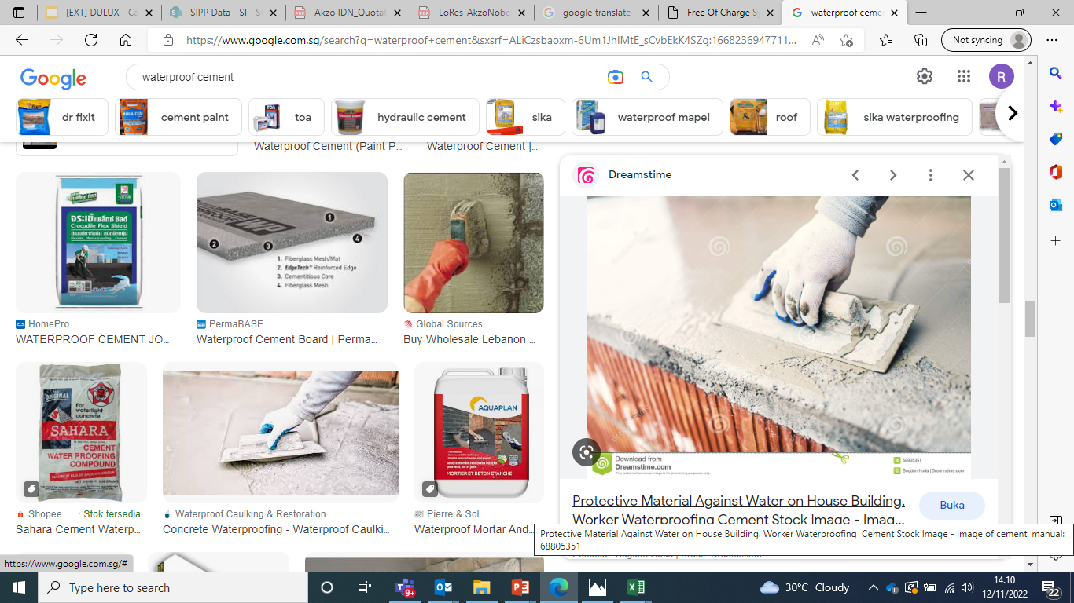
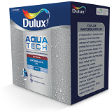
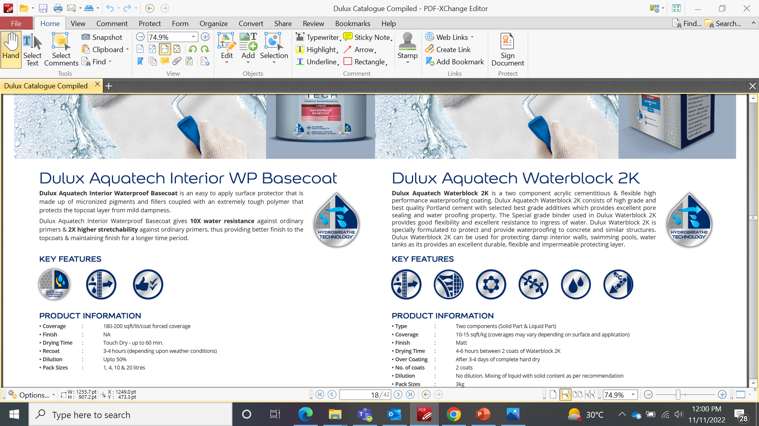
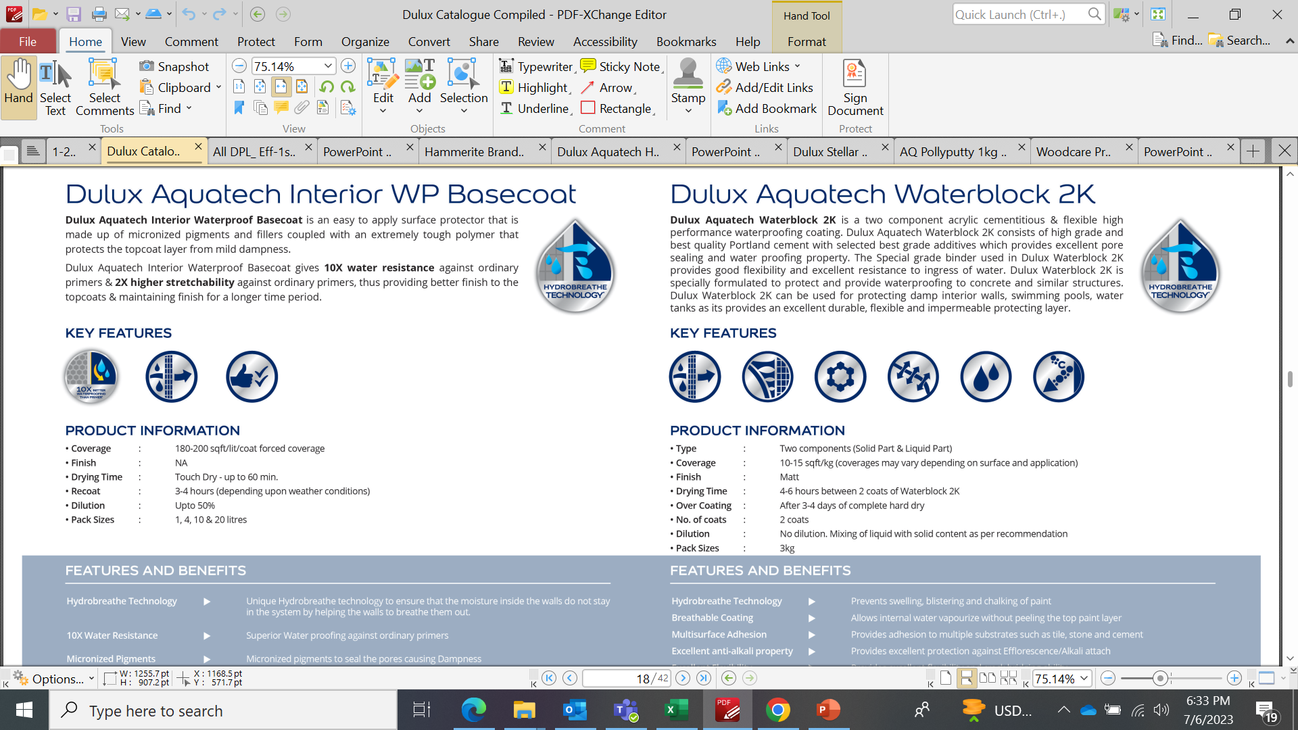
Cementitious - Dulux Aquatech Water Block 2K
Problem Statement
I need a quality waterproofing system for my house to ensure the long life of the building structures as areas such as floors under tiles in bathrooms, kitchens, exterior balconies and swimming pools have water seepage issues due to factors like weather, watercapillars, poor wall surface quality, plumbing. For some reasons cracks can appear and cause water content seeping Rainwater seeps into the paint layer and causes mold / mildew to grow The alkaline salts caused using poor quality bricks and these alkaline salts rise to the surface
Solution
Dulux Aquatech Waterblock 2K is a two-component acrylic cementitious which is specially formulated to provide waterproofing to concrete and similar surfaces. It consists of high grade & best quality Portland cement with selected best grade additives which provides excellent pore sealing and waterproofing property. Dulux Waterblock 2K can be used against moisture in moisture-prone areas such as protecting damp interior walls, swimming pools, water tanks as it provides an excellent durable, flexible and impermeable protecting layer. Equipped with unique Hydrobreathe technology it prevents swelling, blistering and chalking of paints
Benefits
Feel reassured that my house is entirely protected from any seepage & dampness issues even at the most moisture prone locations
Problems
Available in
3KG, 15KG
Solution
Benefit
Keep walls and flooring in wet areas a good as new.
Breathable
Coating
Multi-surface
Adhesion
Excellent
Anti-Alkali
properties
Excellent
Flexibility
Superior
WTP
Superior
Anti-
Carbonation
Properties
Product Features
Application | Interior & Exterior Durable
Coverage | 0.92 – 1.39 m2/Kg Min. 2 coats (recommended)
Finish | NA
Colour Availability | Cementitious - Grey
Waterproofing Substrate | Vertical Walls & Horizontal
Performance | The special grade binder used provides good flexibility and excellent resistance to ingress of water.
Microorganism Protection | Prevents from fungus
Crack Protection | NA
Similar Technology available in ID
(Dulux Aquashield Waterblock 2K),
VN (Dulux WS WTP / WS WTP
Ad Mixture - 1K only)

Slide 16
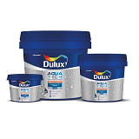


Crack Filler - Dulux Aquatech Crack Filler
Problem Statement
Our house is our pride and biggest investment, built to last for generations. In our humid climate dampness and water seepage impacts the structure and safety of our house. How can be rest assured that I’ve prevented any kind of water leaking & seepage issues for my house? I need a thorough and long lasting solution to get the dampness out and prevent it from coming back
Solution
Dulux Aquatech Crack Fillers are ready mixed, high performance, light weight crack fillers based on Acrylic polymer dispersion. The high grade inert, light weight fillers used in the formulation makes the crack fillers suitable for application on wide variety of surfaces like concrete, plasters and wood in both interior & exterior surfaces. With Unibond Technology, it provides ready to use one-time application solution for every type of exterior and interior cracks
Benefits
Peace of mind in the long run by comprehensive waterproofing of my house
Available in
0.4g, 1Kg, 5Kg (5MM cracks)
0.5Kg ,1Kg.5Kg (10MM cracks)
1Kg & 5Kg (20MM cracks)
Shrink Free
Accepts
nails &
screws
Multi-surface
Adhesion
Quick
Drying
Ease of
sanding
Product Features
Application | Interior & Exterior durable
Coverage | For a crack 5mm wide & 5mm deep – 65-75 rft/kg For a crack 10mm wide & 10mm deep – 50-60 rft/kg For a crack 20mm wide & 20mm deep – 30-40 rft/kg Min. 1 Coat recommended
Finish | NA
Colour Availability | White
Waterproofing Substrate | Vertical Walls & Horizontal (i.e. roofs & terraces)
Performance | One time application since it’s shrink-free
Microorganism Protection | NA
Crack Protection | Provides up to 5mm/10mm/20mm crack bridging properties

Slide 17


Int. Liquid Applied Vertical - Dulux Aquatech Int. WTP BC
Problem Statement
Our house is our pride and biggest investment, built to last for generations. In our humid climate dampness and water seepage impacts the structure and safety of our house. I want to protect my house upfront by preventing the occurrence of dampness & water seepage issues
Solution
Dulux Aquatech Interior Waterproof Basecoat is a single component liquid applied waterproofing solution that forms a breathable memberane and helps to prevent surface dampness of the interior walls. It is made up of micronized pigments & fillers coupled with an extremely tough polymer that protects the topcoat layer from mild dampness. With unique Hydrobreathe Technology, it ensures that the moisture inside the walls does not stay in the system by helping the walls to breathe the moisture out.
Benefits
Stay worry free when it comes to protection of my house from any dampness and seepages issues
Available in
1, 4, 10 & 20L
10X Water Resistance
Micronized
Pigments
Enhanced Top
Coat Life
Other benefits:
Micronized pigments to seal the pores causing dampness
Improves top coat performance & finish
Product Features
Application | Interior durable
Coverage | 16.7-18.5 m2/lt/coat forced coverage Min. 2 coats (recommended)
Finish | NA
Colour Availability | White
Waterproofing Substrate | Vertical Walls
Performance | Gives 10X water resistance & 2X higher stretchability (vs ordinary primers)
Microorganism Protection | NA
Crack Protection | NA
Similar Technology available in PK
(Dulux Aquashield Interior
Basecoat)

Slide 18


Int. Liquid Applied Vertical - Dulux Aquatech Int. WTP BC Advance
Problem Statement
Our house is our pride and biggest investment, built to last for generations. In our humid climate dampness and water seepage impacts the structure and safety of our house. I want to protect my house upfront by preventing the occurrence of dampness & water seepage issues
Solution
Dulux Aquatech Interior Waterproof Basecoat Advance is a single component liquid applied waterproofing solution for interior surfaces which provides a long term solution against interior waterproofing issues like dampness and alkali attack . Thus keeping the film integrity intact for a longer period of time.
Benefits
Stay worry free when it comes to protection of my house from any dampness and seepages issues
Available in
1, 4, 10 & 20L
Product Features
Application | Interior durable
Coverage | 4.6-5.57/lt/coat forced coverage
Finish | NA
Colour Availability | White
Waterproofing Substrate | Vertical Walls
Performance | Gives 10X water resistance & 2X higher stretchability (vs ordinary primers)
Microorganism Protection | NA
Crack Protection | 0.5mm

Slide 19



Ext. Liquid Applied Vertical - Dulux Aquatech Flexible WTP BC
Problem Statement
Our house is our pride and biggest investment, built to last for generations. In our humid climate dampness and water seepage impacts the structure and safety of our house. I want to protect my house upfront by preventing the occurrence of dampness & water seepage issues
Solution
Dulux Aquatech Flexible Waterproof Basecoat provides excellent water resistance. It provides 10 years of waterproofing protection and is tough enough for normal roof as well as sidewall usage. With unique Hydroshield Technology, it bridges cracks and covers the porous wall surface with a thick protective film, preventing water seepage, carbonation and fungal attacks.
Benefits
Stay worry free when it comes to protection of my house from any dampness and seepages issues
Available in
1L, 4L & 20L
Superior
WTP
Protection
Latex Film
Superior
Binders
Quick Drying
Sun Reflect
Technology
Product Features
Application | Exterior Vertical Surfaces
Coverage | 4.1-5.6 m2/lt/coat for smooth surface with low porosity 2.7-4.1 m2/lt/coat for absorbent surface with high porosity Min. 1 coat (recommended)
Finish | NA
Colour Availability | White
Waterproofing Substrate | Vertical Walls
Performance | It provides 10 years of waterproofing protection
Microorganism Protection | NA
Crack Protection | Upto 3mm with WS PF
Similar Technology available in PK
(Dulux Aquashield Flexible WTP
Basecoat), VN (Dulux Aquatech
Flexible WTP, ID (Dulux
Aquashield Flexible WTP), LK
(Dulux Aquatech Flexible WTP)

Slide 20


Ext. Liquid Applied Vertical - Dulux Aquatech WTP BC
Problem Statement
Our house is our pride and biggest investment, built to last for generations. In our humid climate dampness and water seepage impacts the structure and safety of our house. I want to protect my house upfront by preventing the occurrence of dampness & water seepage issues
Solution
Dulux Aquatech Waterproof Basecoat provides excellent water resistance. It provides 8 years of waterproofing protection and is tough enough for normal roof as well as sidewall usage. With unique DampResist Technology, forms a tough film that prevents water seepage, bridges cracks and prevents fungal attacks.
Benefits
Stay worry free when it comes to protection of my house from any dampness and seepages issues
Available in
1L, 4L & 20L
Product Features
Application | Exterior Vertical Surfaces
Coverage | 4.1-5.6 m2/lt/coat for smooth surface with low porosity 2.7-4.1 m2/lt/coat for absorbent surface with high porosity Min. 1 coat (recommended)
Finish | NA
Colour Availability | White
Waterproofing Substrate | Vertical Walls
Performance | It provides 8 years of waterproofing protection
Microorganism Protection | NA
Crack Protection | Upto 2mm with WS Max and PF

Slide 21





Pre-Treatment Coat - Dulux Aquatech Pre-Treatment Coat
Problem Statement
Our house is our pride and biggest investment, built to last for generations. In our humid climate dampness and water seepage impacts the structure and safety of our house. How do I stop dampness from causing fungus and mould in the interior and exterior of my house?
Solution
Dulux Aquashield Pre Treatment Coat is a water based, acrylic coating for application on surfaces before painting to reduce and prevent growth of fungi and algae on surfaces With FungiClean Technology, it reduces and prevents growth of fungi & algae on surfaces
Benefits
Peace of mind that my house is protected from algal & fungal infection and my family is in a safe environment
Available in
1L
Other benefits:
Antimicrobial properties help to destroy fungal and algal infection from the root
Protection against bio-attacks due to harsh weather conditions
Anti-Microbial
Pack
Surface Prep
Wash
Product Features
Application | Exterior durable
Coverage | 111 sqmt/lt/coat Min. 1 coat (recommended)
Finish | NA
Colour Availability | NA
Waterproofing Substrate | Vertical Walls & Horizontal
Performance | It’s unique film forming property retains the preservatives much longer for protection against bio-attacks due to harsh weather conditions, thereby enhancing performance of expensive top coat material
Microorganism Protection | Prevents algae & fungi and its reoccurrence
Crack Protection | NA
Similar Technology available in LK
(Dulux Aquatech Fungicidal wash),
PK (Aquashield Pre-Treatment
Coat)

Slide 22



Putty - Dulux Aquatech Waterproofing Putty
Problem Statement
Our house is our pride and biggest investment, built to last for generations. In our humid climate dampness and water seepage impacts the structure and safety of our house. How can be rest assured that I’ve prevented any kind of water leaking & seepage issues for my house? I need a thorough and long lasting solution to get the dampness out and prevent it from coming back
Solution
Dulux Aquatech WTP Wall Putty is a premium quality powder putty that is specially designed with silicone and anti-efflorescence additives to give unique waterproofing properties and efflorescence resistance for a smooth finish and extended life to the top coats. It contains finest quality minerals, white cement, redispersible polymers and special additives
Benefits
Peace of mind in the long run by comprehensive waterproofing of my house
Available in
1Kg & 40 Kg
High Water Resistance
High Adhesive Strength
Product Features
Application | Interior & Exterior durable
Coverage | 8.3 - 10.2 sqm/Kg Min. 2 coats (recommended)
Finish | NA
Colour Availability | White
Waterproofing Substrate | Vertical Walls & Ceilings
Performance | It is developed as a base coat to cover unevenness and pinholes in plastered surfaces and to make the walls/ceilings ready for painting
Microorganism Protection | NA
Crack Protection | NA

Slide 23




Integral - Dulux Aquatech Repair Polymer
Problem Statement
Our house is our pride and biggest investment, built to last for generations. In our humid climate dampness and water seepage impacts the structure and safety of our house. How can be rest assured that I’ve prevented any kind of water leaking & seepage issues for my house? I need a thorough and long lasting solution to get the dampness out and prevent it from coming back
Solution
Dulux Aquatech Repair Pro Latex -Waterproof Repair Polymer (WRP) is a ready to use multipurpose latex-based bonding additive for use in mortars, bond coats, and waterproofing primers. Its Ultradense Technology helps in increasing the compressive strength and thus provide higher resistance to water penetration
Benefits
Stay worry free when it comes to protection of my house from any dampness and seepages issues
Problems
Solution
Available in
0.5Kg, 1Kg, 5Kg & 20Kg
Benefit
High
Adhesive
Strength
Improves
Hardness &
Abrasion
Resistance
Reduces
Shrinkage
Keep walls and flooring in wet areas a good as new.
Multipurpose
High
Compressive
Strength
High
Water
Resistance
Product Features
Application | Interior & Exterior Durable
Coverage | 1.8-2.0 m2/lt/coat
Finish | NA
Colour Availability | NA
Waterproofing Substrate | Repairing damaged concrete, columns, beams, and chajjas. Also used for waterproofing of toilets, balconies, and sunken areas.
Performance | Resistance to water pressure is 2-3 bars
Microorganism Protection | NA
Crack Protection | NA

Slide 24


Integral - Dulux Aquatech Repair Pro latex
Problem Statement
Our house is our pride and biggest investment, built to last for generations. In our humid climate dampness and water seepage impacts the structure and safety of our house. How can be rest assured that I’ve prevented any kind of water leaking & seepage issues for my house? I need a thorough and long lasting solution to get the dampness out and prevent it from coming back
Solution
Dulux Aquatech Repair Pro Latex is a superior performing modified SBR (Styrene Butadiene Rubber) based repair polymer. It is used for the repair of old concrete, columns, beams, chajjas, waterproofing of toilets, balconies and sinking areas. It reduces shrinkage of concrete & thereby does not let crack form in the concrete even after multiple years. It contains plasticizers that improves the workability of the cement mix at low water ratios, providing better cohesion & bonding. Can be used as an additive in Bond Coat, Repair Mortar, Warterproofing Coat, Concrete Repair
Benefits
Stay worry free when it comes to protection of my house from any dampness and seepages issues
Problems
Solution
Available in
0.5Kg, 1Kg, 5Kg & 20Kg
Benefit
Keep walls and flooring in wet areas a good as new.
Product Features
Application | Interior & Exterior Durable
Coverage | 1.8-2.0 m2/lt/coat for Bond Coar
Finish | NA
Colour Availability | NA
Waterproofing Substrate | Repairing damaged concrete, columns, beams, and chajjas. Also used for waterproofing of toilets, balconies, and sunken areas.
Performance | Resistance to water pressure is 2-3 bars
Microorganism Protection | NA
Crack Protection | NA

Slide 25


Integral - Dulux Aquatech Super Plast+
Problem Statement
Our house is our pride and biggest investment, built to last for generations. In our humid climate dampness and water seepage impacts the structure and safety of our house. How can be rest assured that I’ve prevented any kind of water leaking & seepage issues for my house? I need a thorough and long lasting solution to get the dampness out and prevent it from coming back
Solution
Dulux Aquatech SUPERPLAST+ is an integral liquid waterproofing compound advance formulated with water reducers & super plasticizers for cement concrete, mortar, and plasters. It makes concrete cohesive & improves workability of the mix. The compound has been designed to be used even with M-sand, improving its workability & thereby increasing its compactness. The product is formulated with selected surface-active super plasticizing agents, chemicals & additives which make the cement concrete/ plaster mix more compact upon curing, reduces water permeability.
Benefits
Stay worry free when it comes to protection of my house from any dampness and seepages issues
Problems
Solution
Available in
0.5Kg, 1Kg, 5Kg & 20Kg
Benefit
Keep walls and flooring in wet areas a good as new.
Product Features
Application | Integral Waterproofing
Dosage | 200ml/50Kg Cement
Finish | NA
Colour Availability | NA
Waterproofing Substrate | Repairing damaged concrete, columns, beams, and chajjas. Also used for waterproofing of toilets, balconies, and sunken areas.
Performance | Resistance to water pressure is 2-3 bars
Microorganism Protection | NA
Crack Protection | NA

